Slide 1
SCHOOL MANAGEMENT SYSTEM
WORK FLOW

Slide 2
A WALKTHROUGH OF ALL WORKING FEATURES

Slide 3
LOGIN CREDENTIALS
ADMIN MODULE:-
Username : navyamanjarihyd443@gmail.com
Password : 12345678
TEACHER MODULE :-
Username : teacher1
Password : 12345678
STUDENT MODULE:-
Username : student12
Password : 12345678

Slide 4
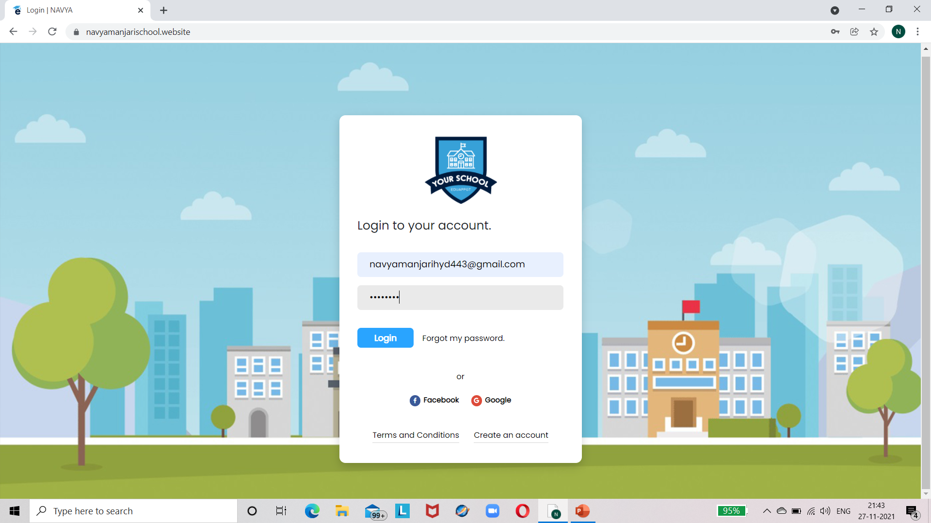
LOGIN PAGE :-

Slide 5
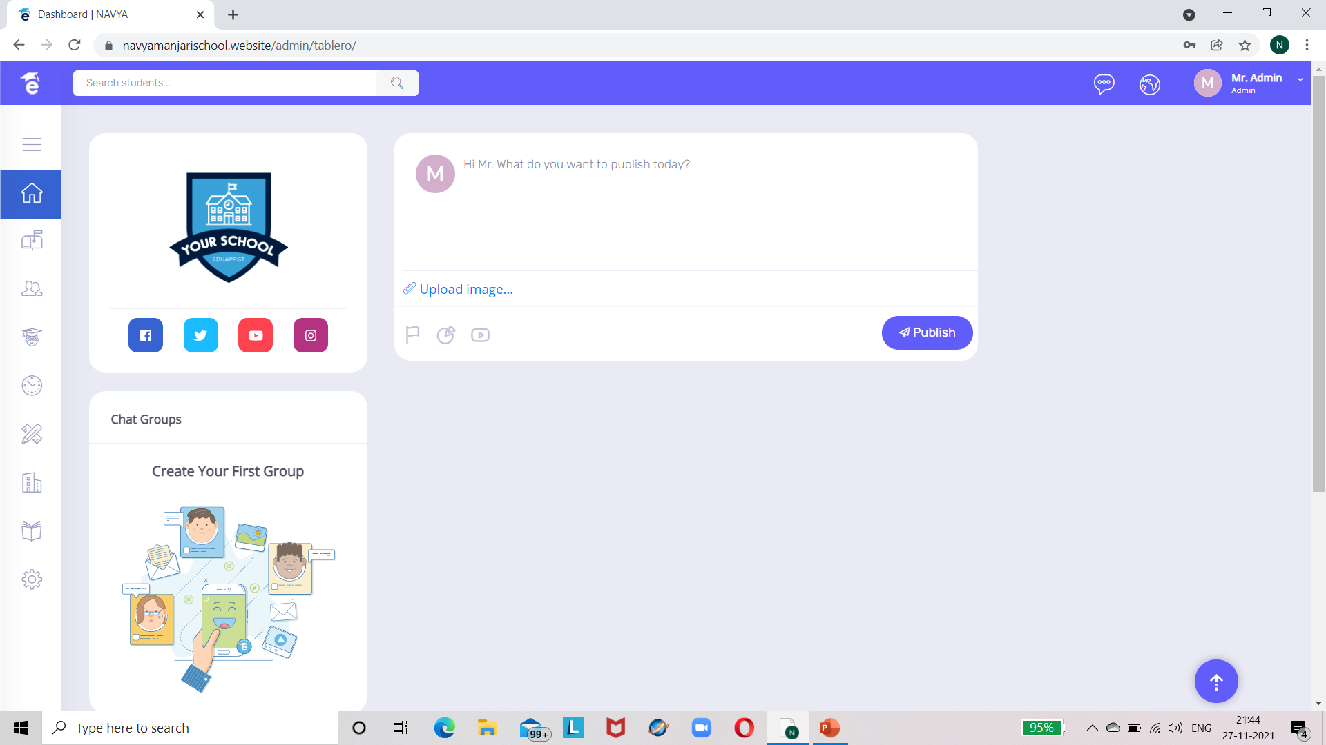
ADMIN MODULE :-

Slide 6
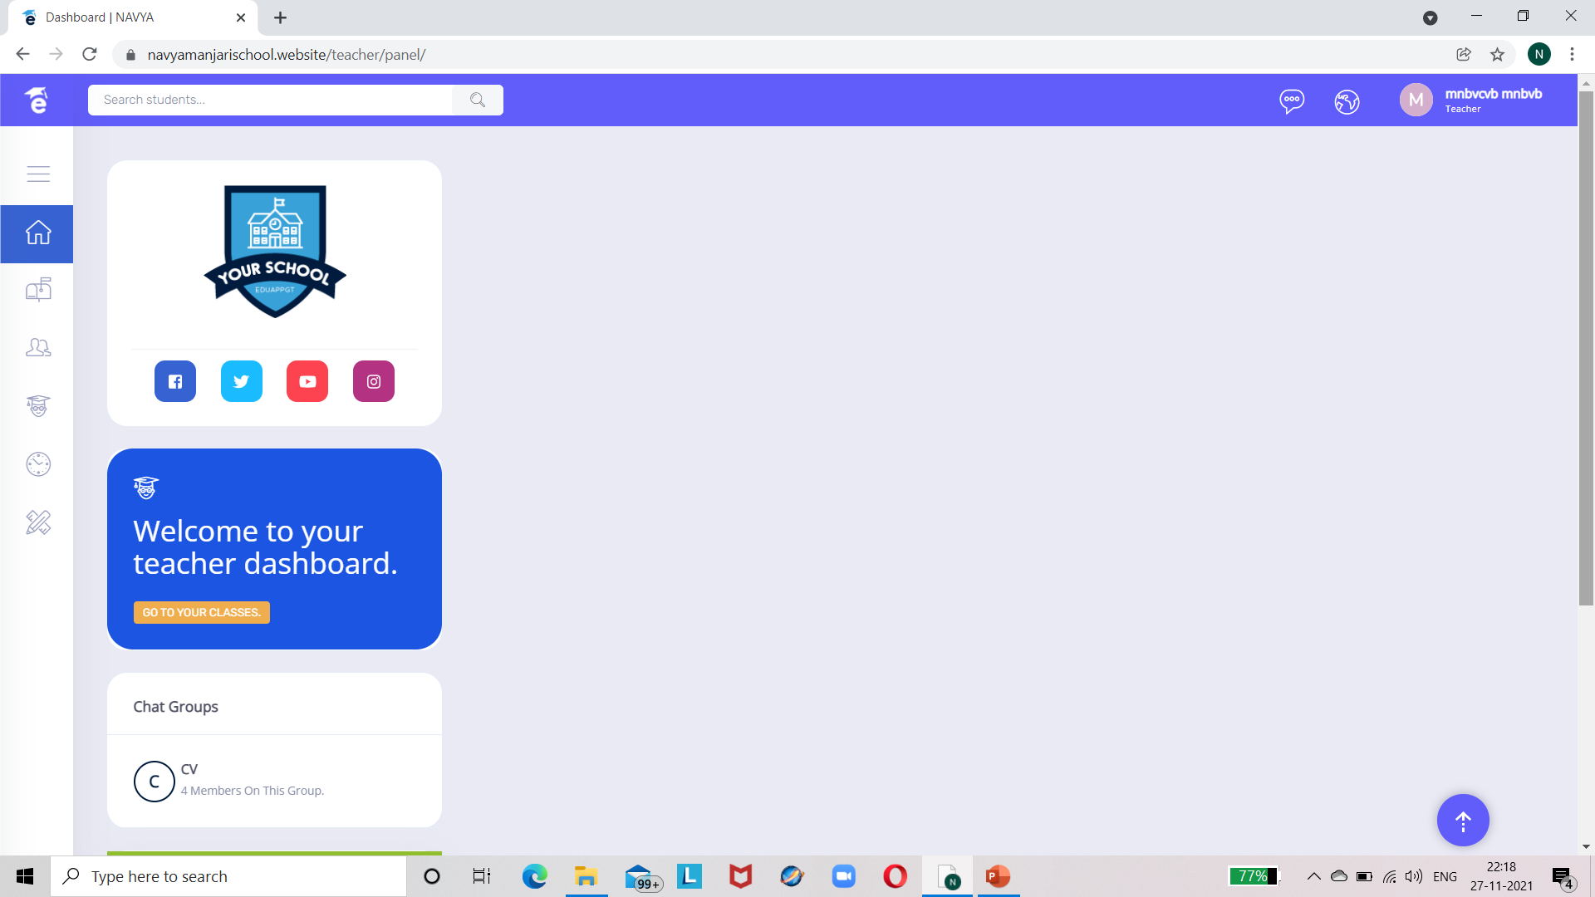
TEACHER MODULE :-

Slide 7
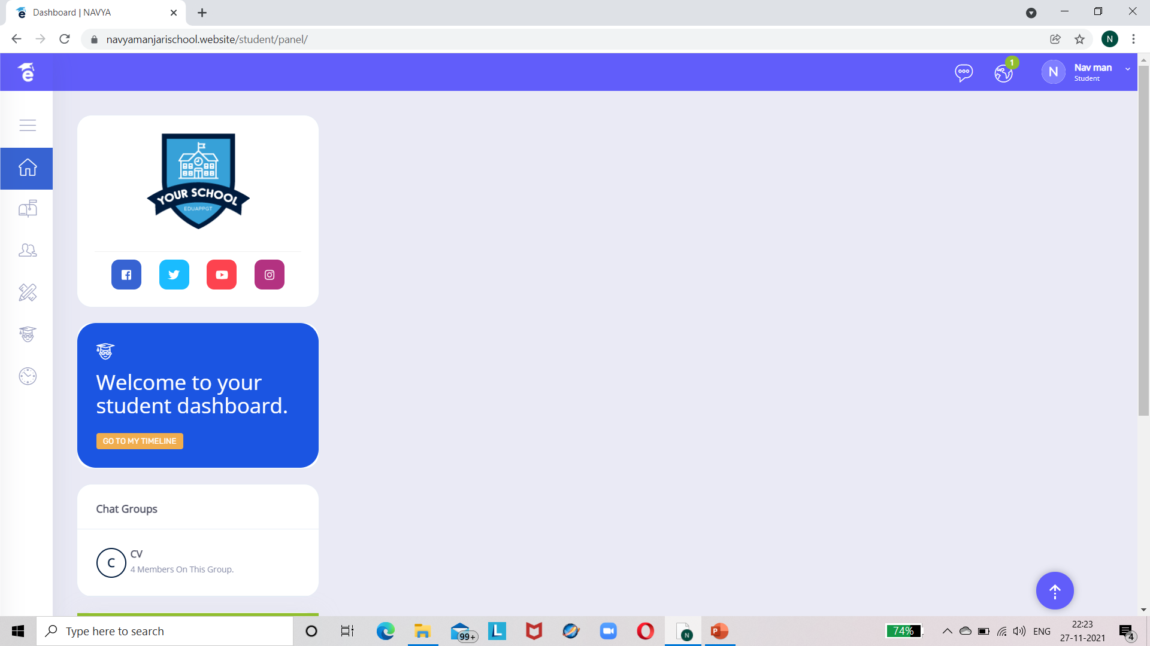
STUDENT MODULE :-

Slide 8
WALK THROUGH ADMIN MODULE :-

Slide 9
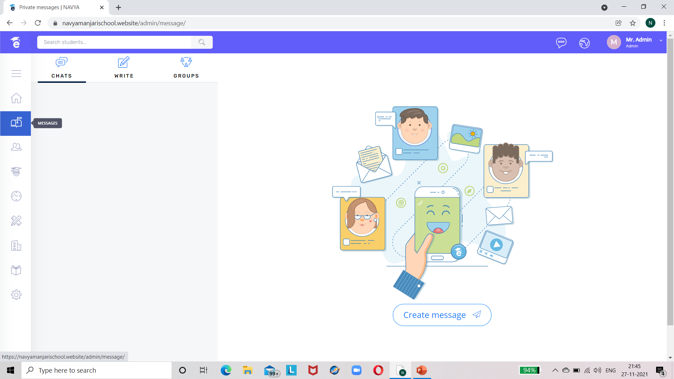

MESSAGES TAB:-

Slide 10
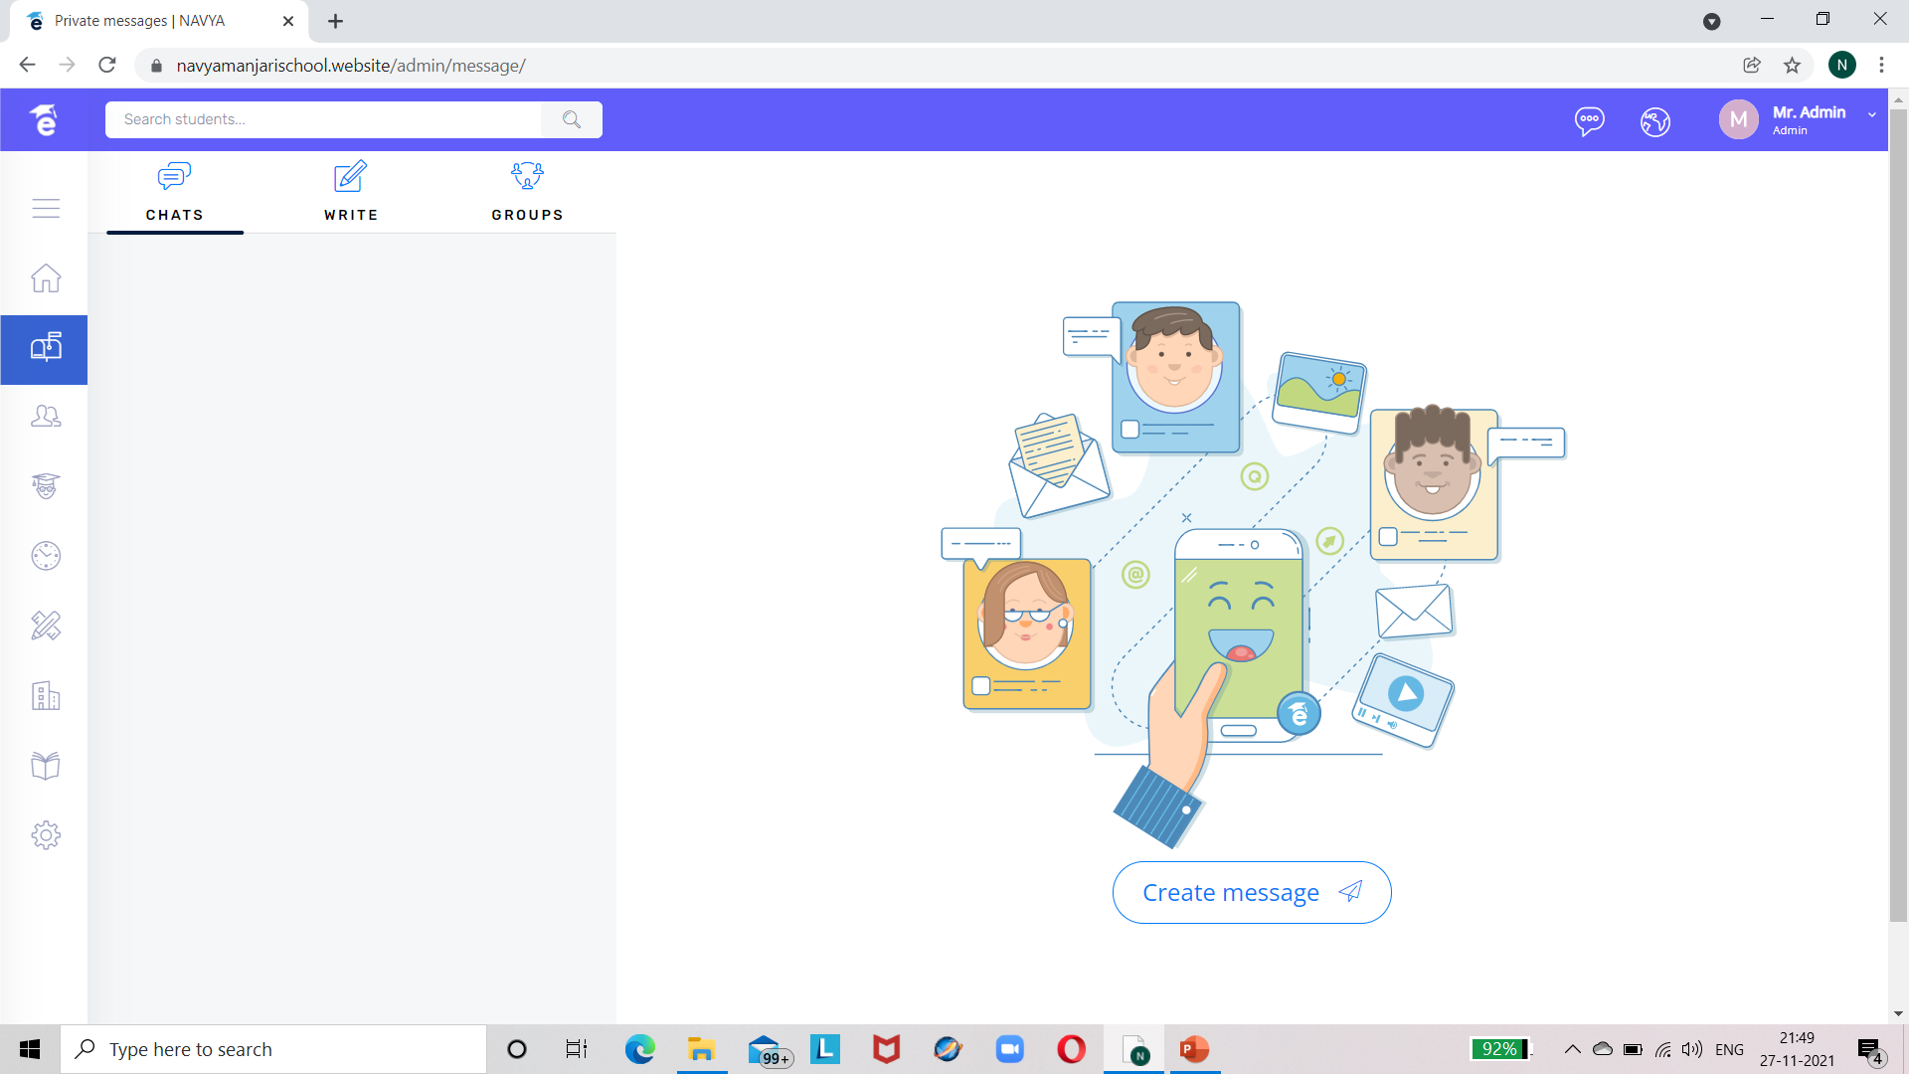


CLICK ON MESSAGES ICON DEPICTED IN PREVIOUS SLIDE

Slide 11
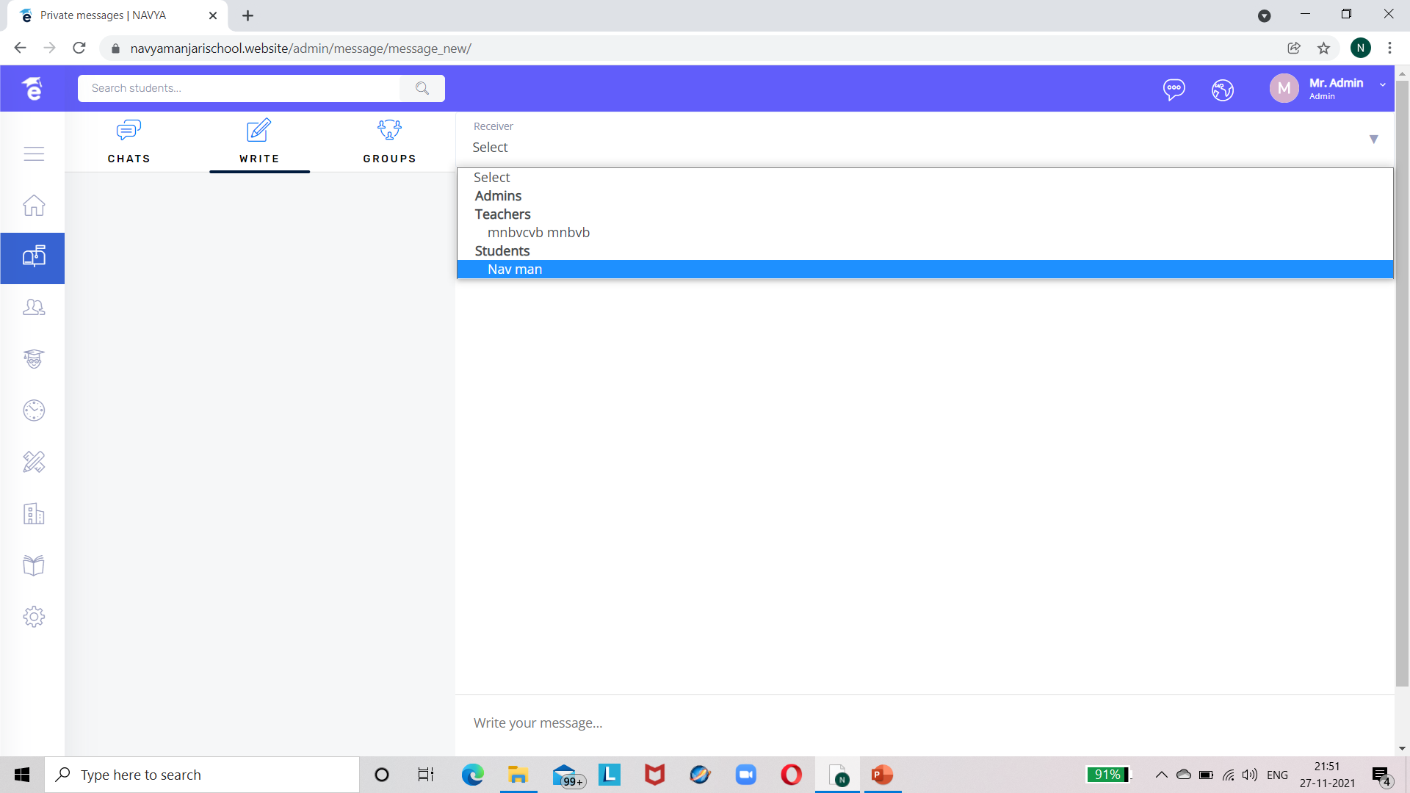

SELECT RECEIVER TO WHOM THE MESSAGE HAS TO BE SENT

Slide 12
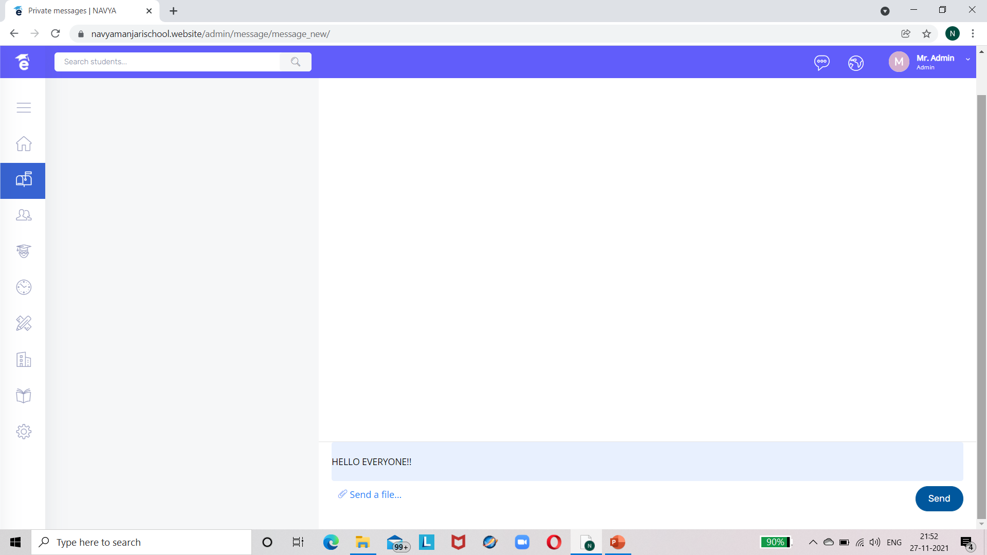


MESSAGE SENDING

Slide 13
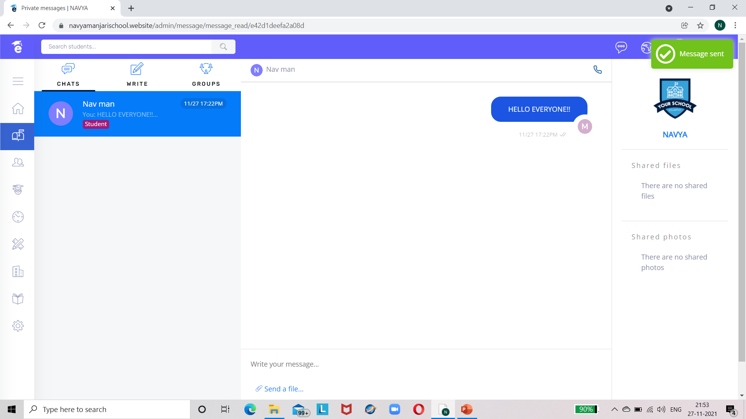
MESSAGE SENT

Slide 14
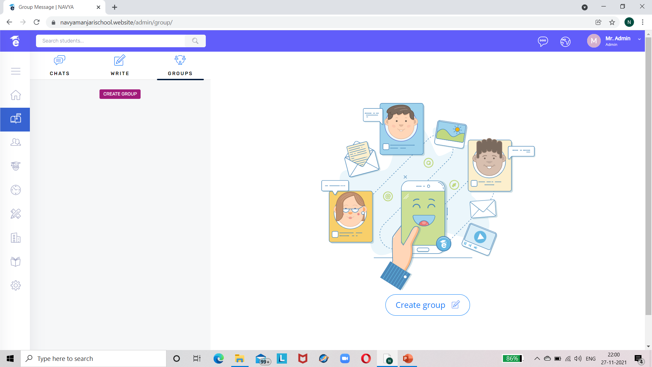


GROUP CHAT

Slide 15
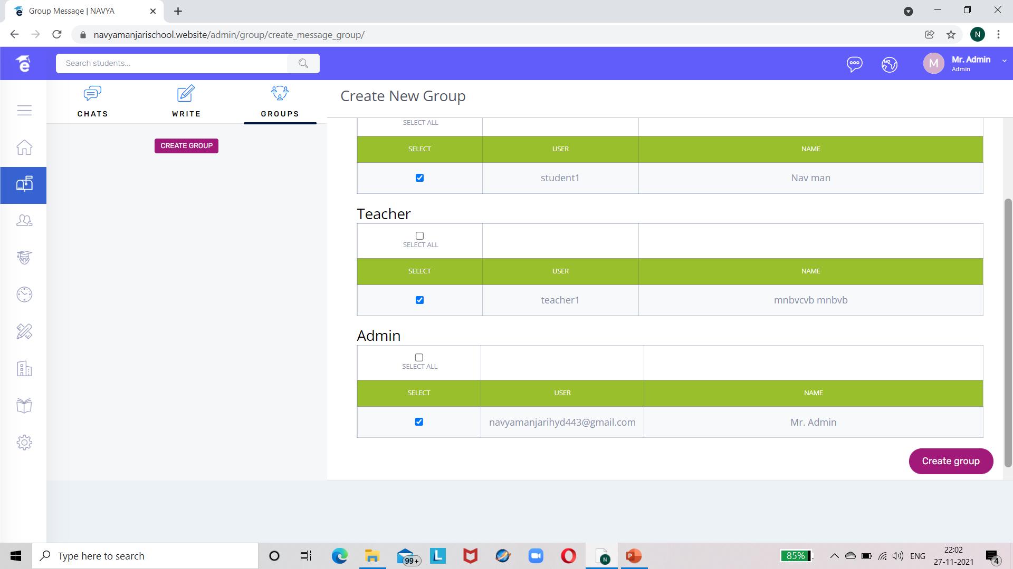


CREATE GROUP

Slide 16
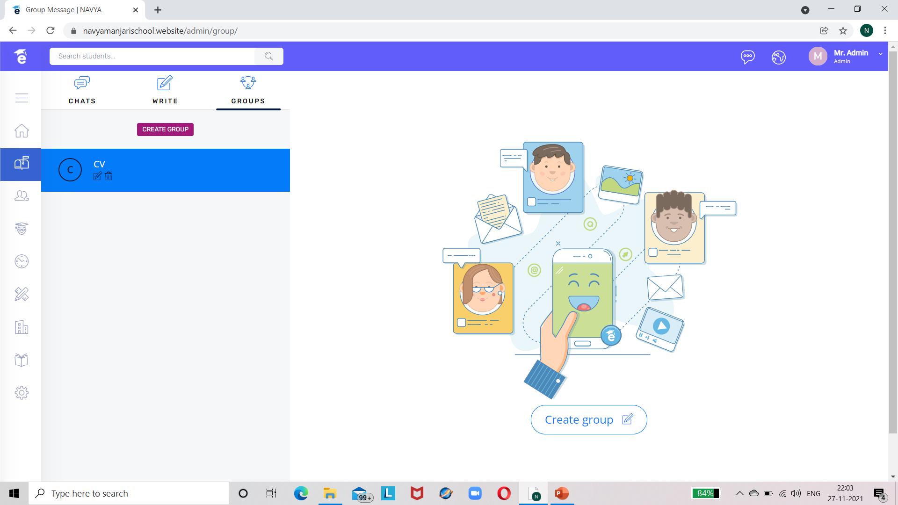

CREATED GROUP CLICK ON IT

Slide 17
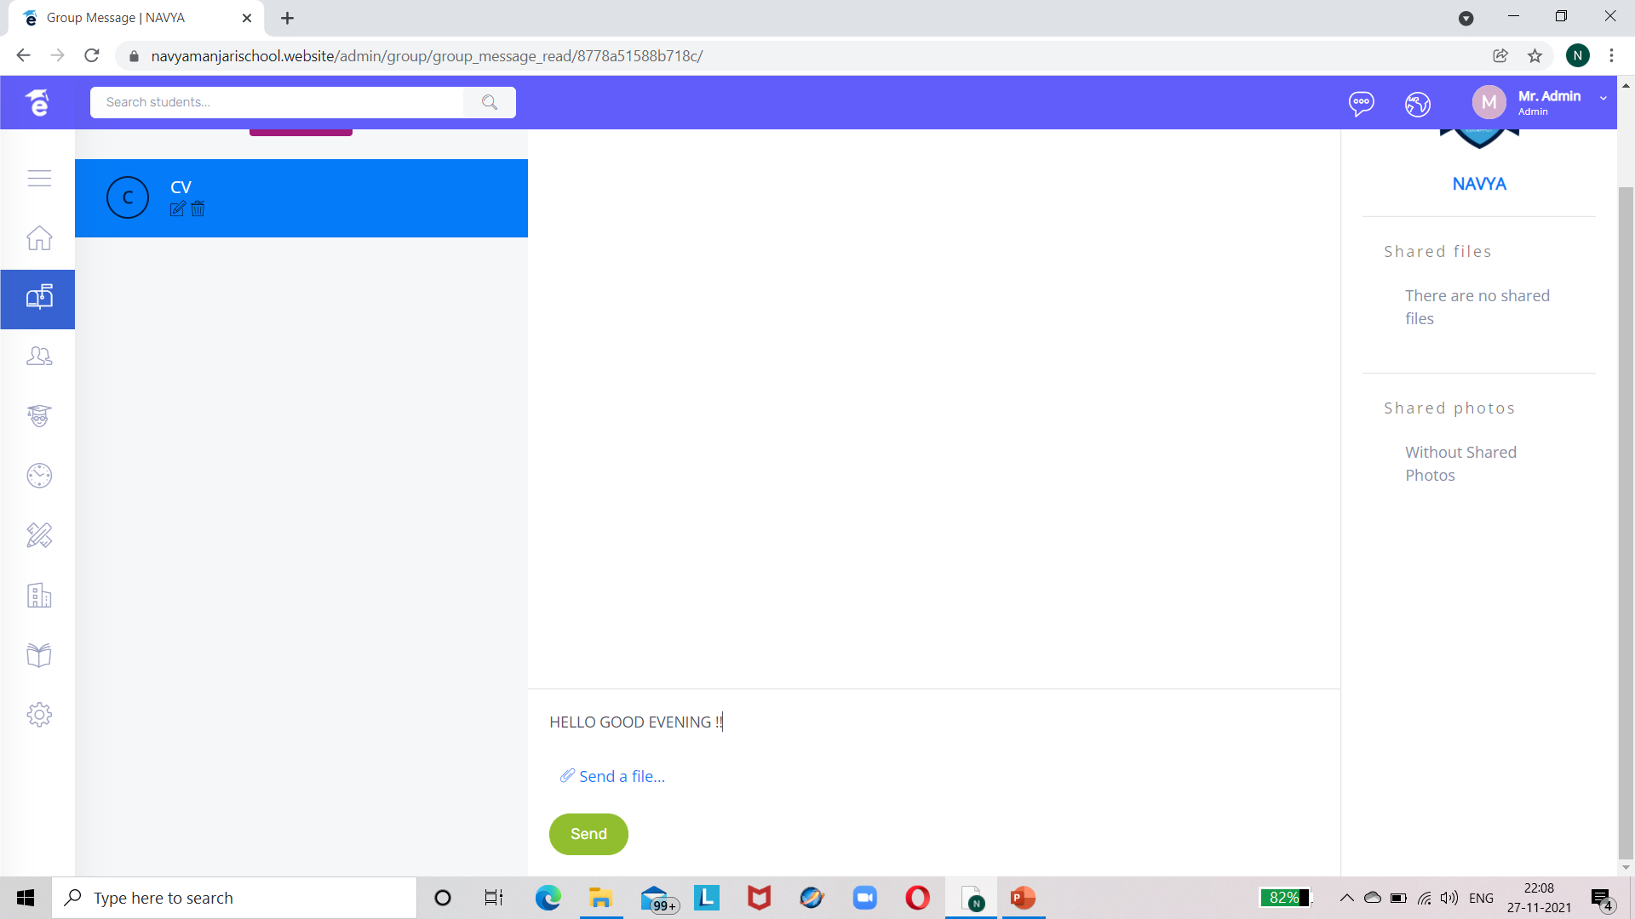

CHAT WITH GROUP MEMBERS

Slide 18
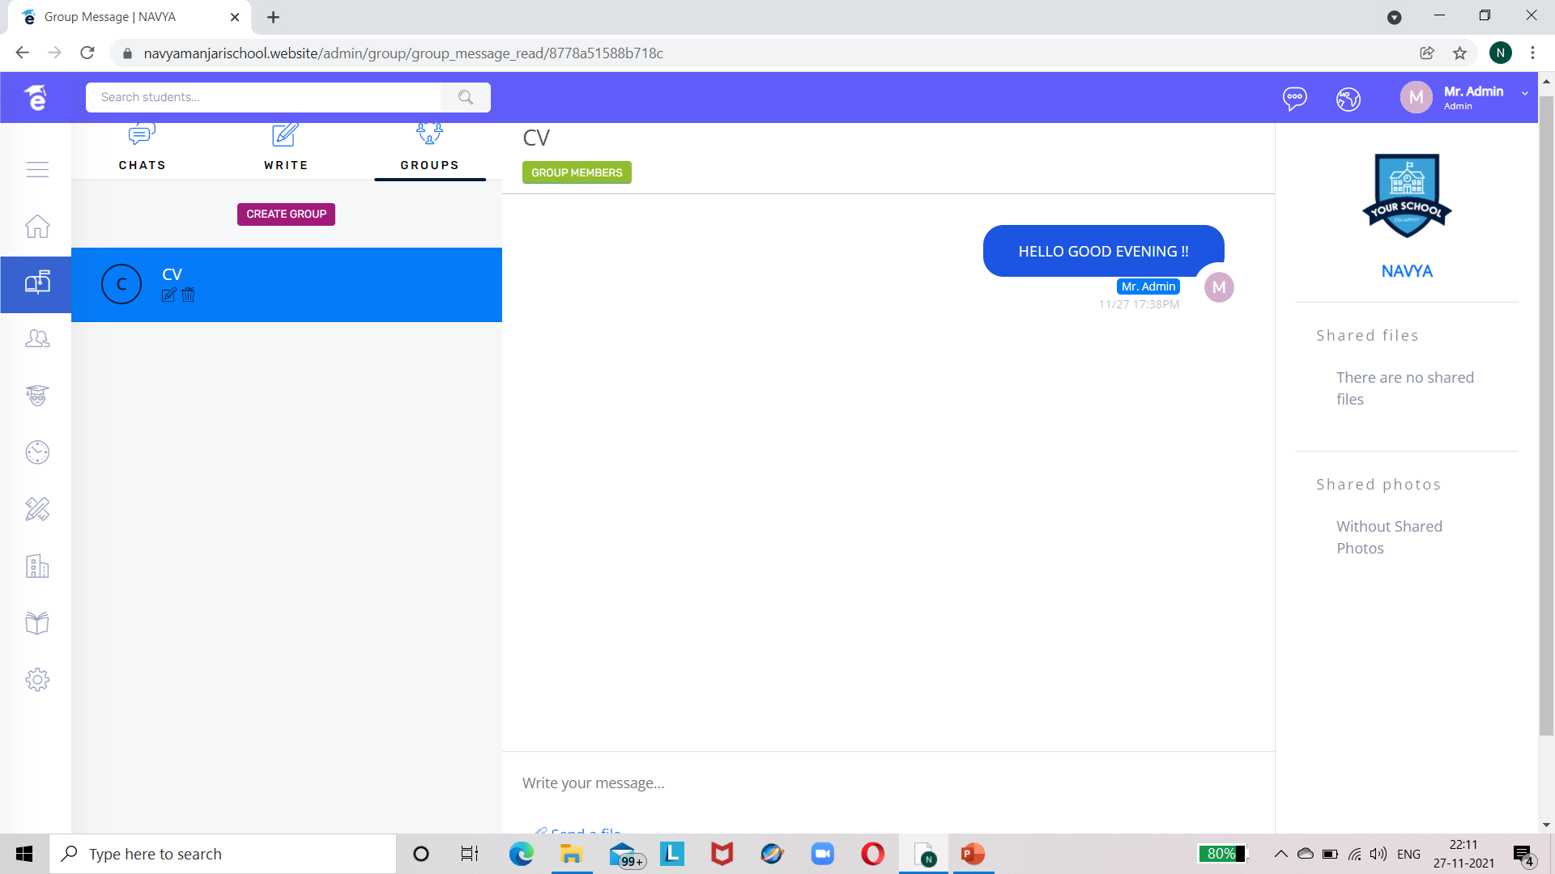
CHAT POSTED BY ADMIN

Slide 19
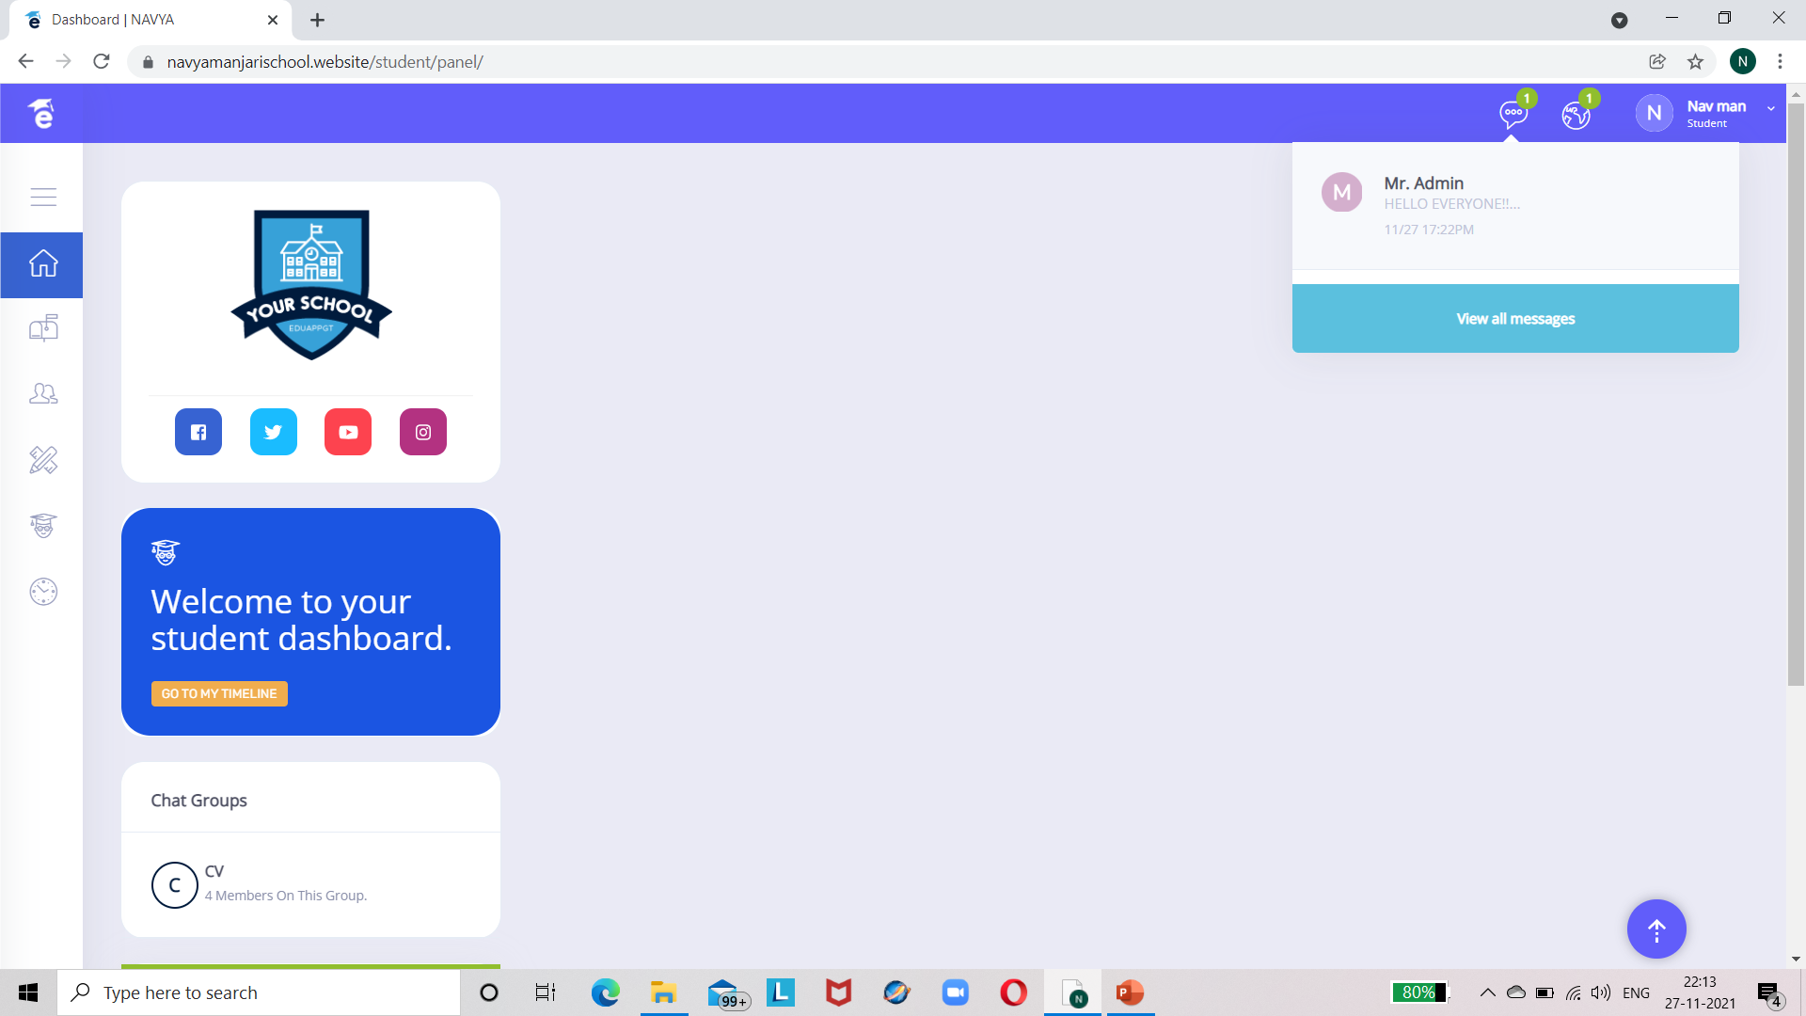

CHAT VIEWED BY STUDENT

Slide 20
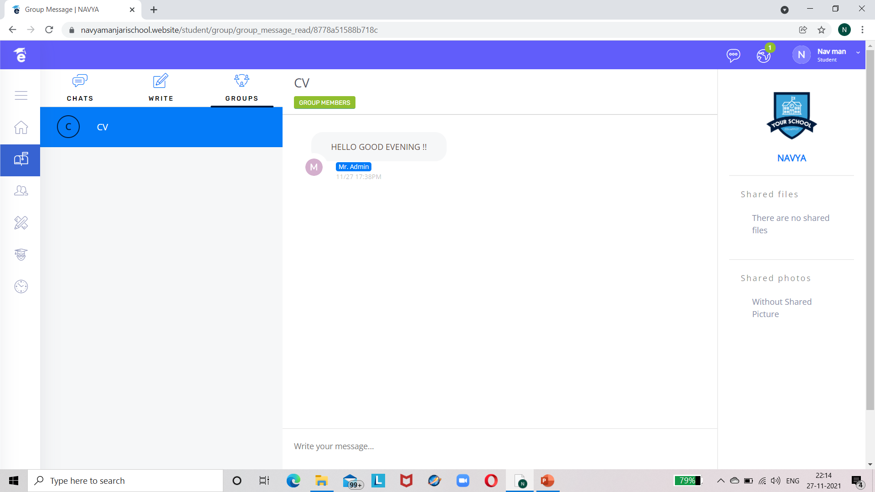

Slide 21
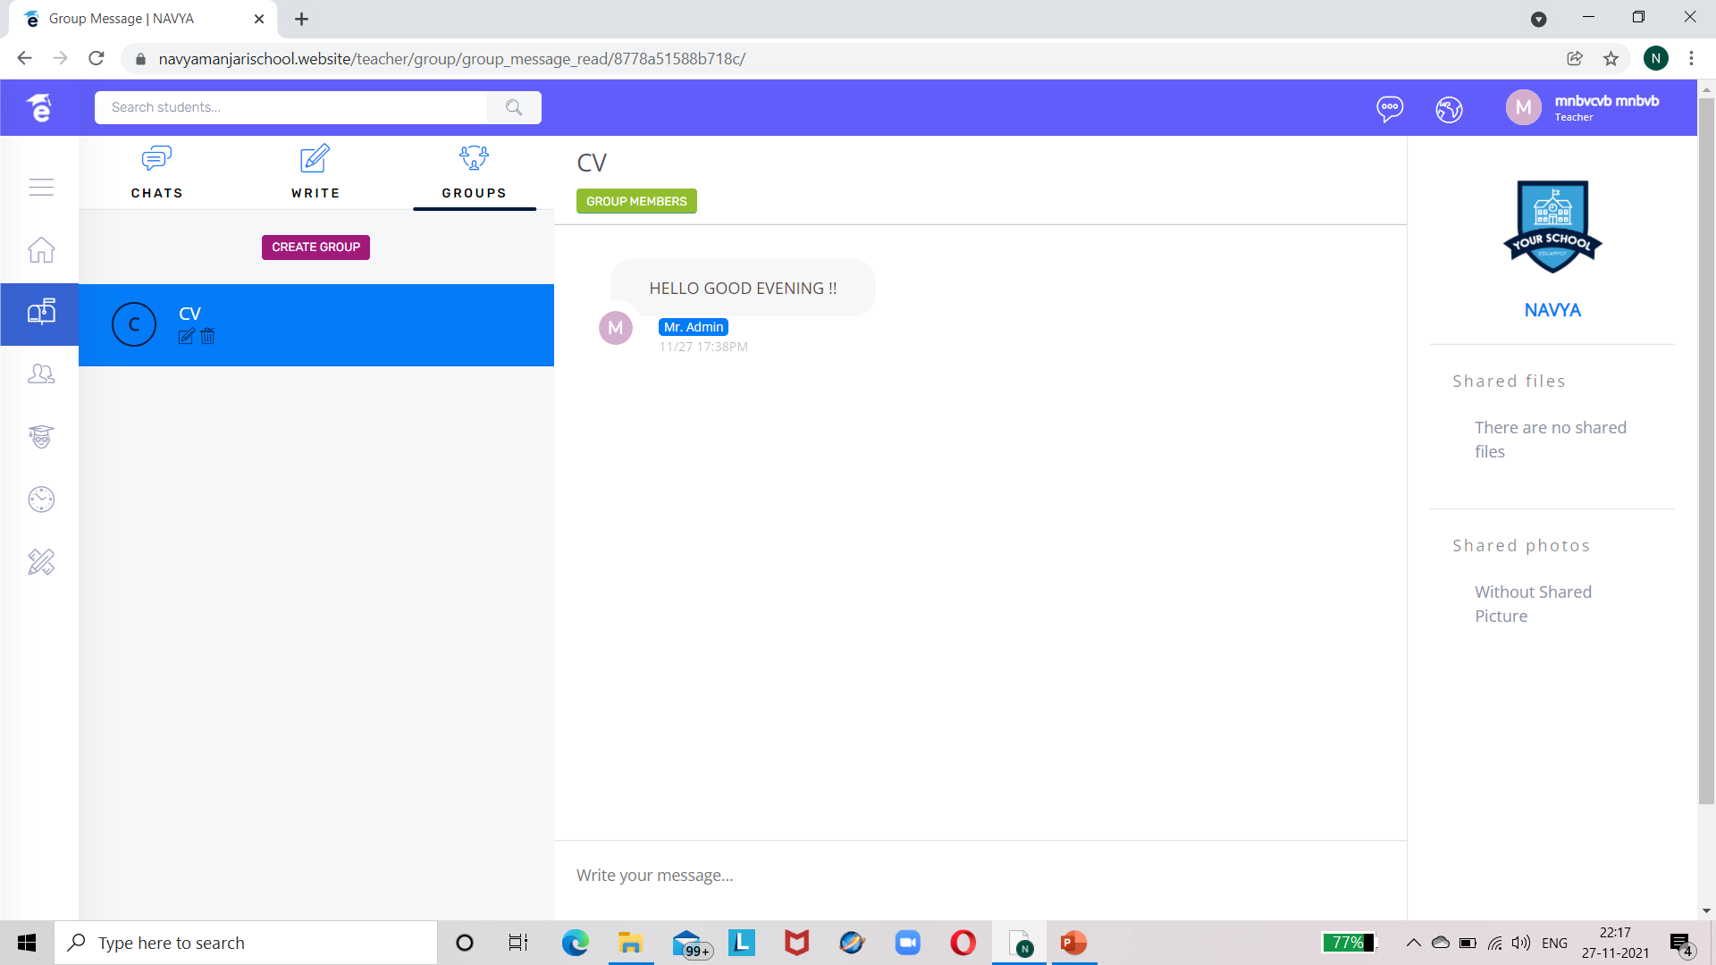
CHAT VIEWED BY TEACHER

Slide 22
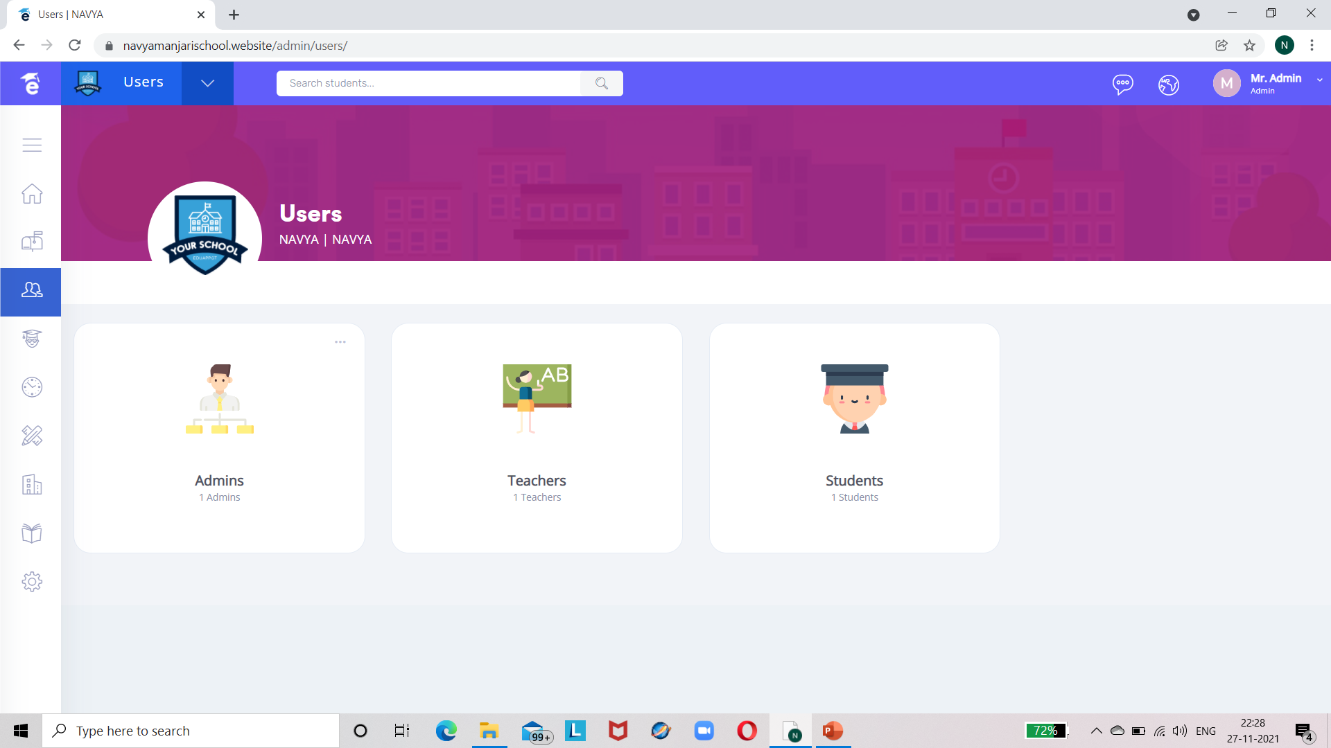

USERS TAB :-

Slide 23
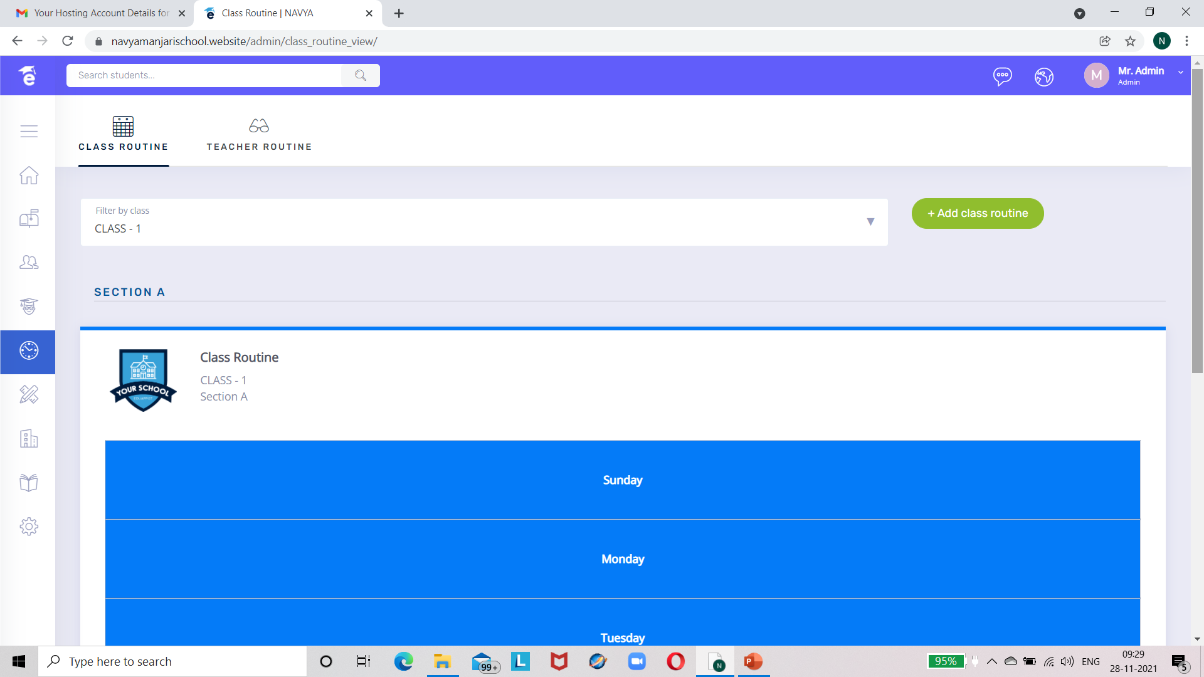
CLASS ROUTINE TAB WHERE ADMIN CAN ADD CLASS ROUTINE AND TEACHER ROUTINE :-

Slide 24
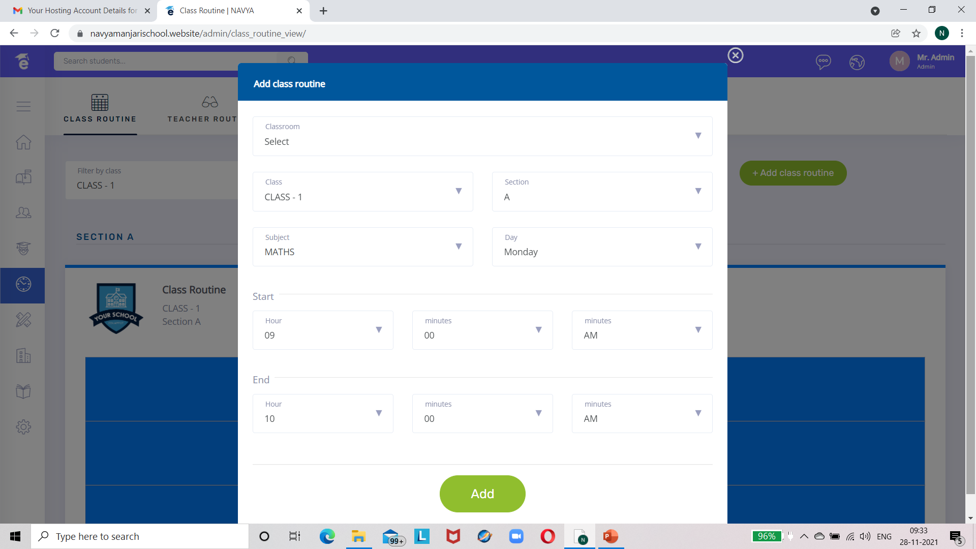

Slide 25
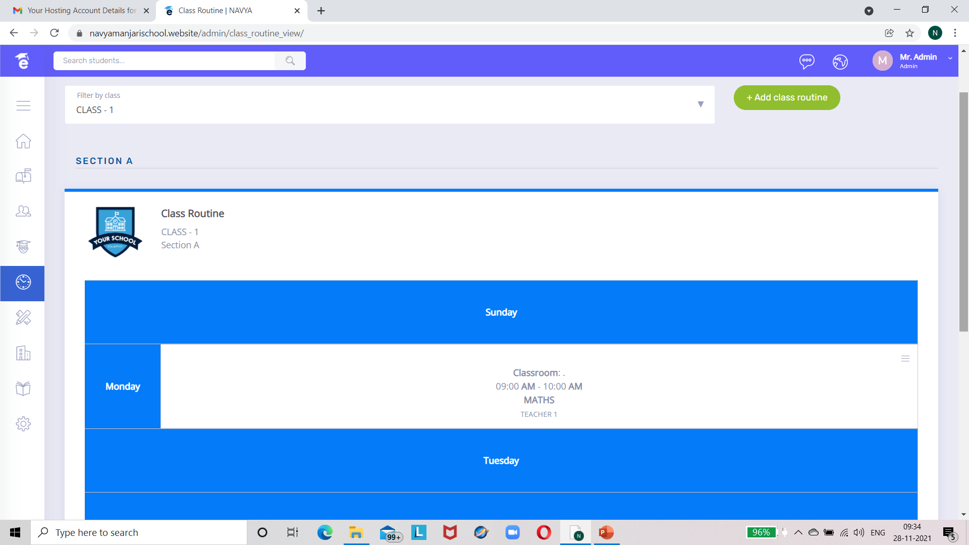

Slide 26
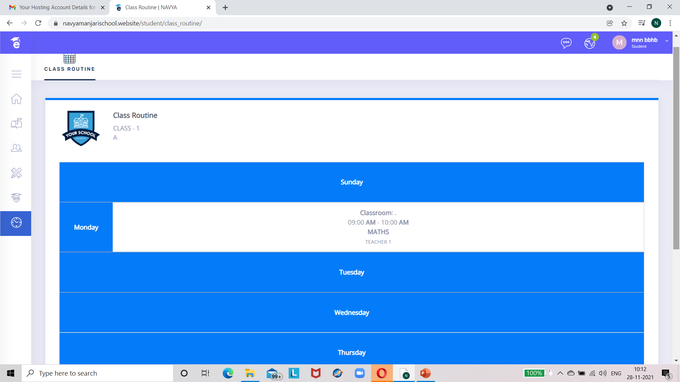
CLASS ROUTINE VIEWED BY STUDENT IN STUDENT MODULE :-

Slide 27
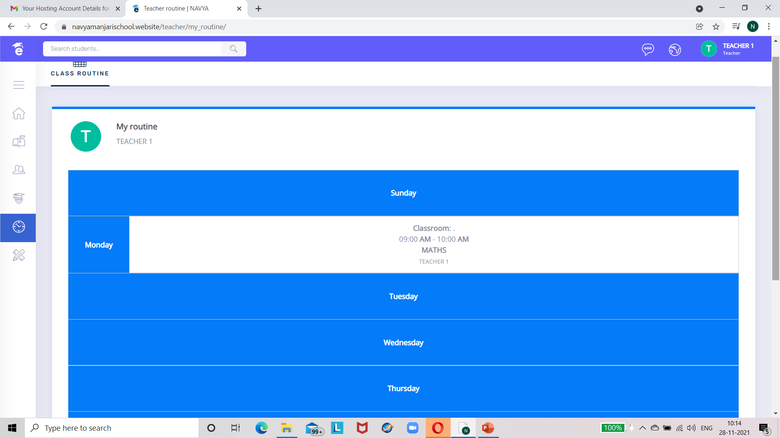
CLASS ROUTINE VIEWED BY TEACHER IN TEACHER MODULE :-

Slide 28
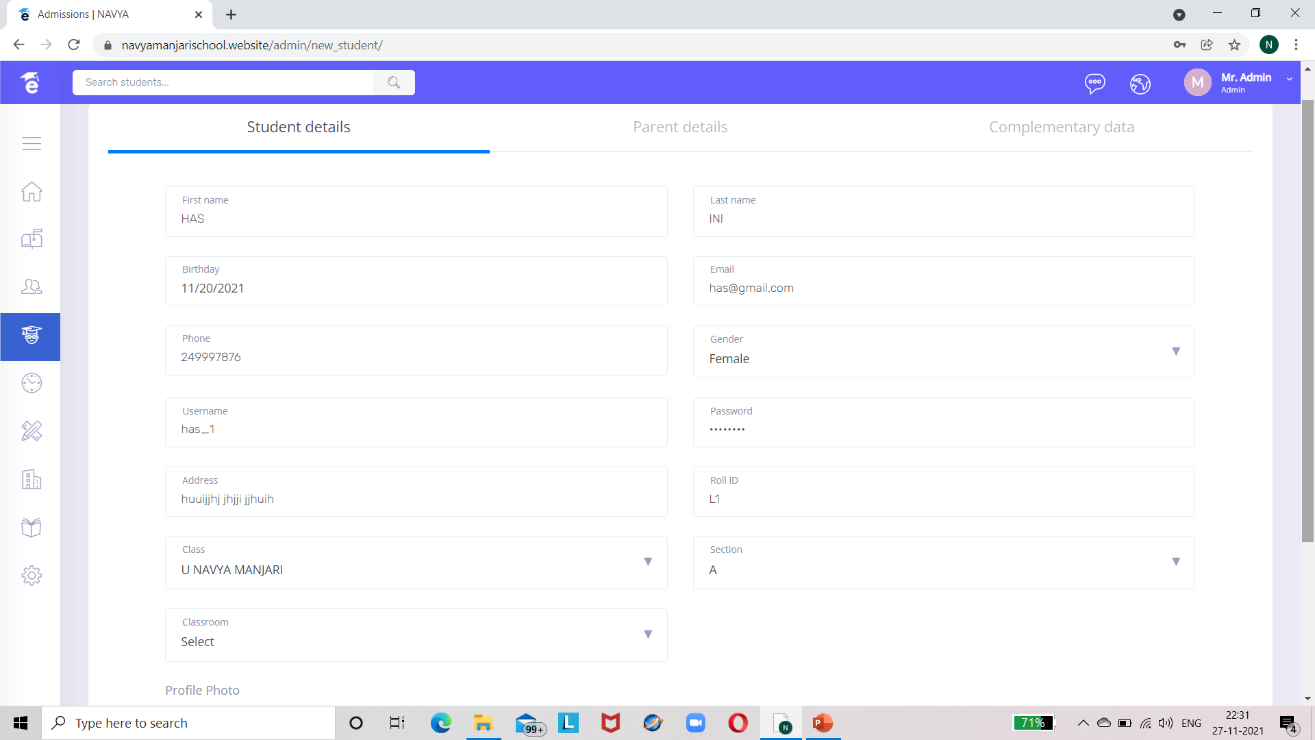

ADMISSIONS TAB :-

Slide 29
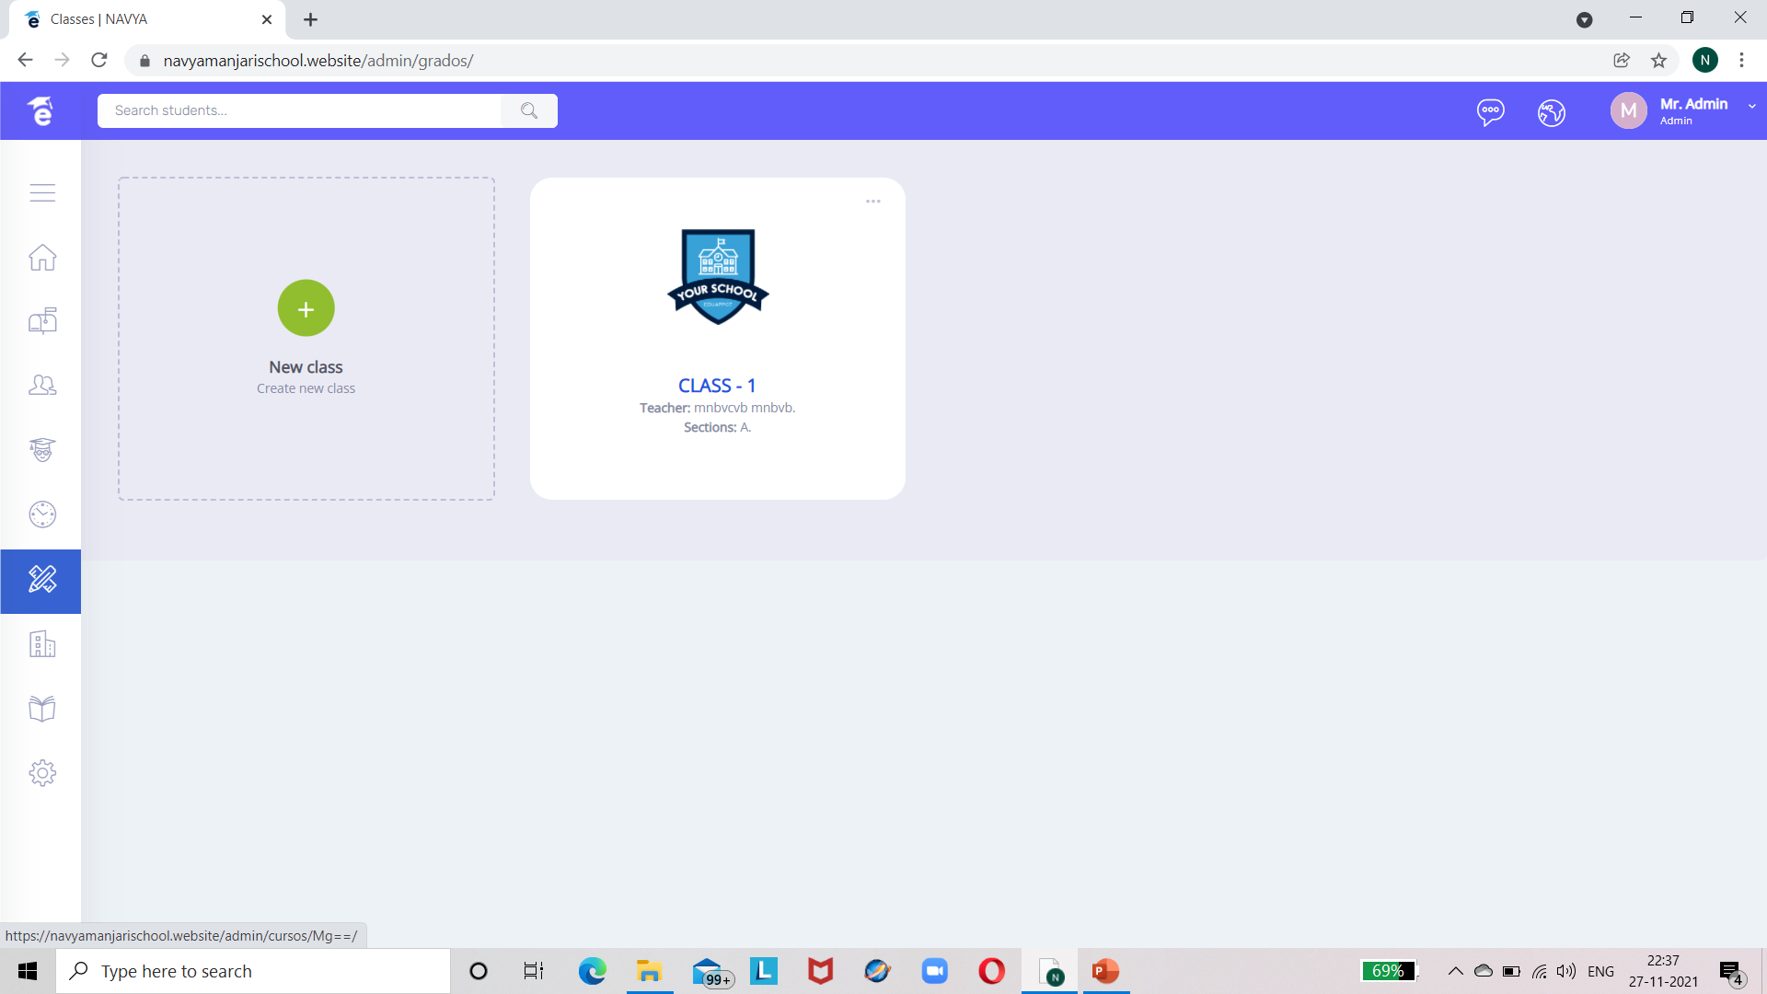

ACADEMIC TAB :- (CLICK ON CLASS-1)

Slide 30
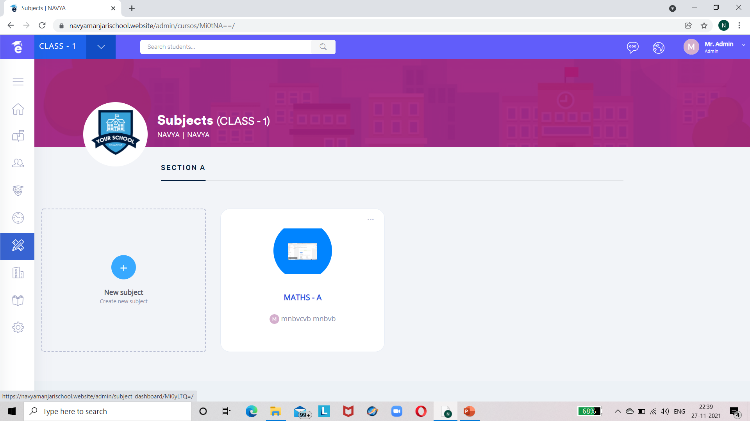

CLICK ON MATHS-A :-

Slide 31
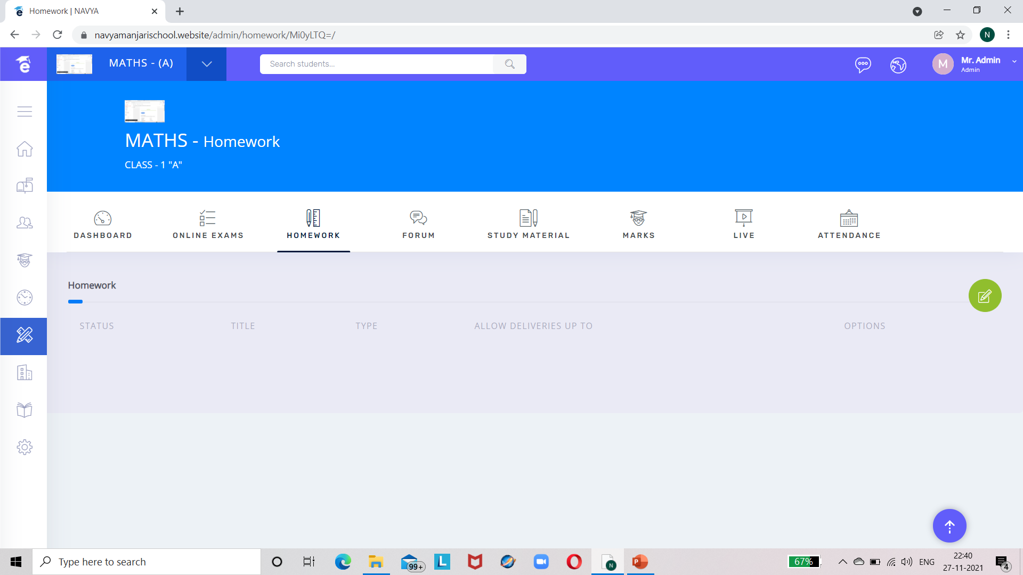

HOME WORK TAB(ASSIGNMENTS):-CLICK ON GREEN ICON TO CREATE HOMEWORK

Slide 32
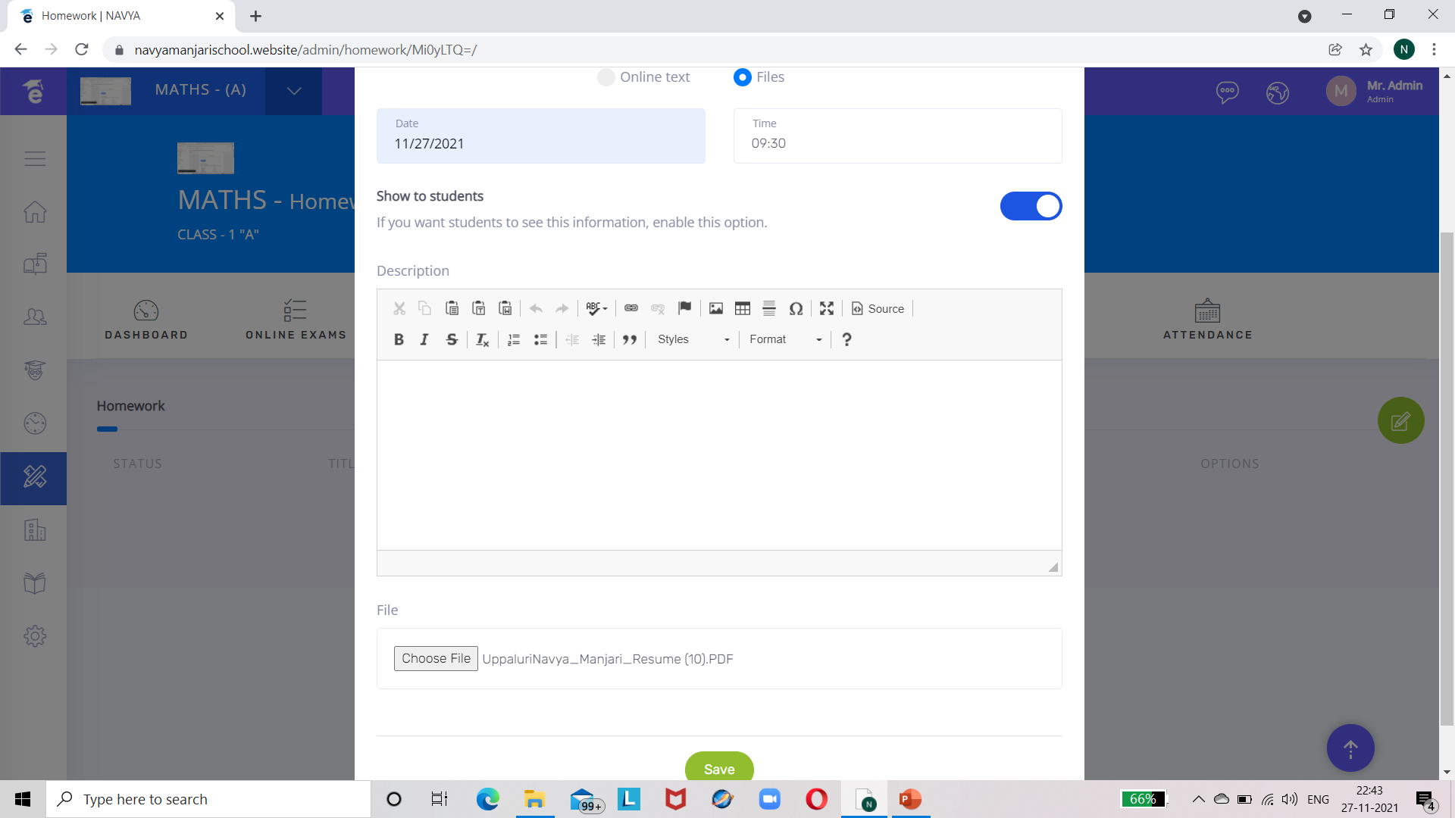
HOMEWORK (ASSIGNMENT) CREATED BY ADMIN :-

Slide 33
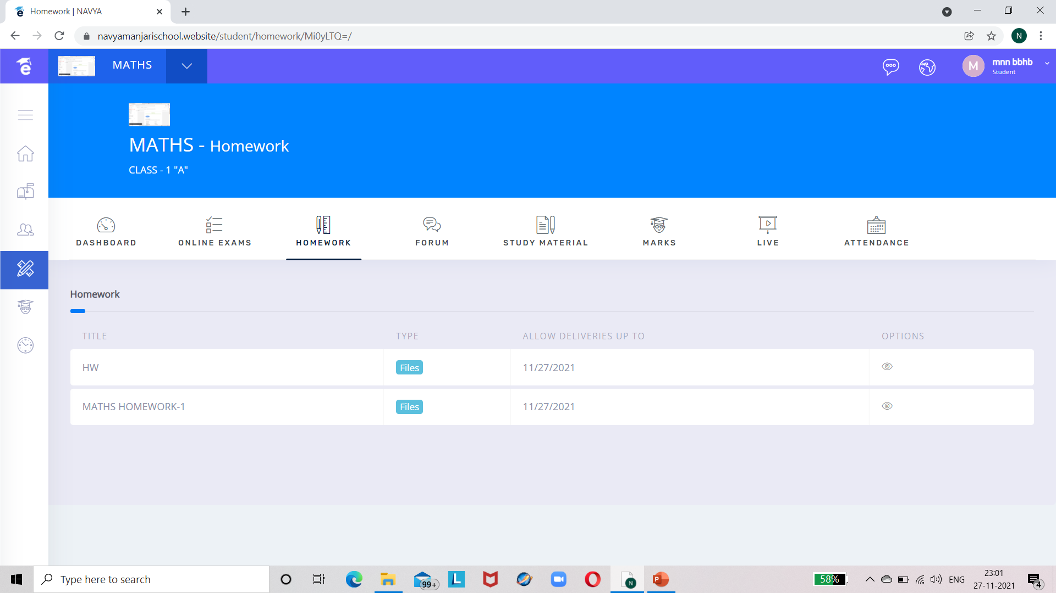




HOMEWORK(ASSIGNMENT) VIEWED BY STUDENT :-

Slide 34
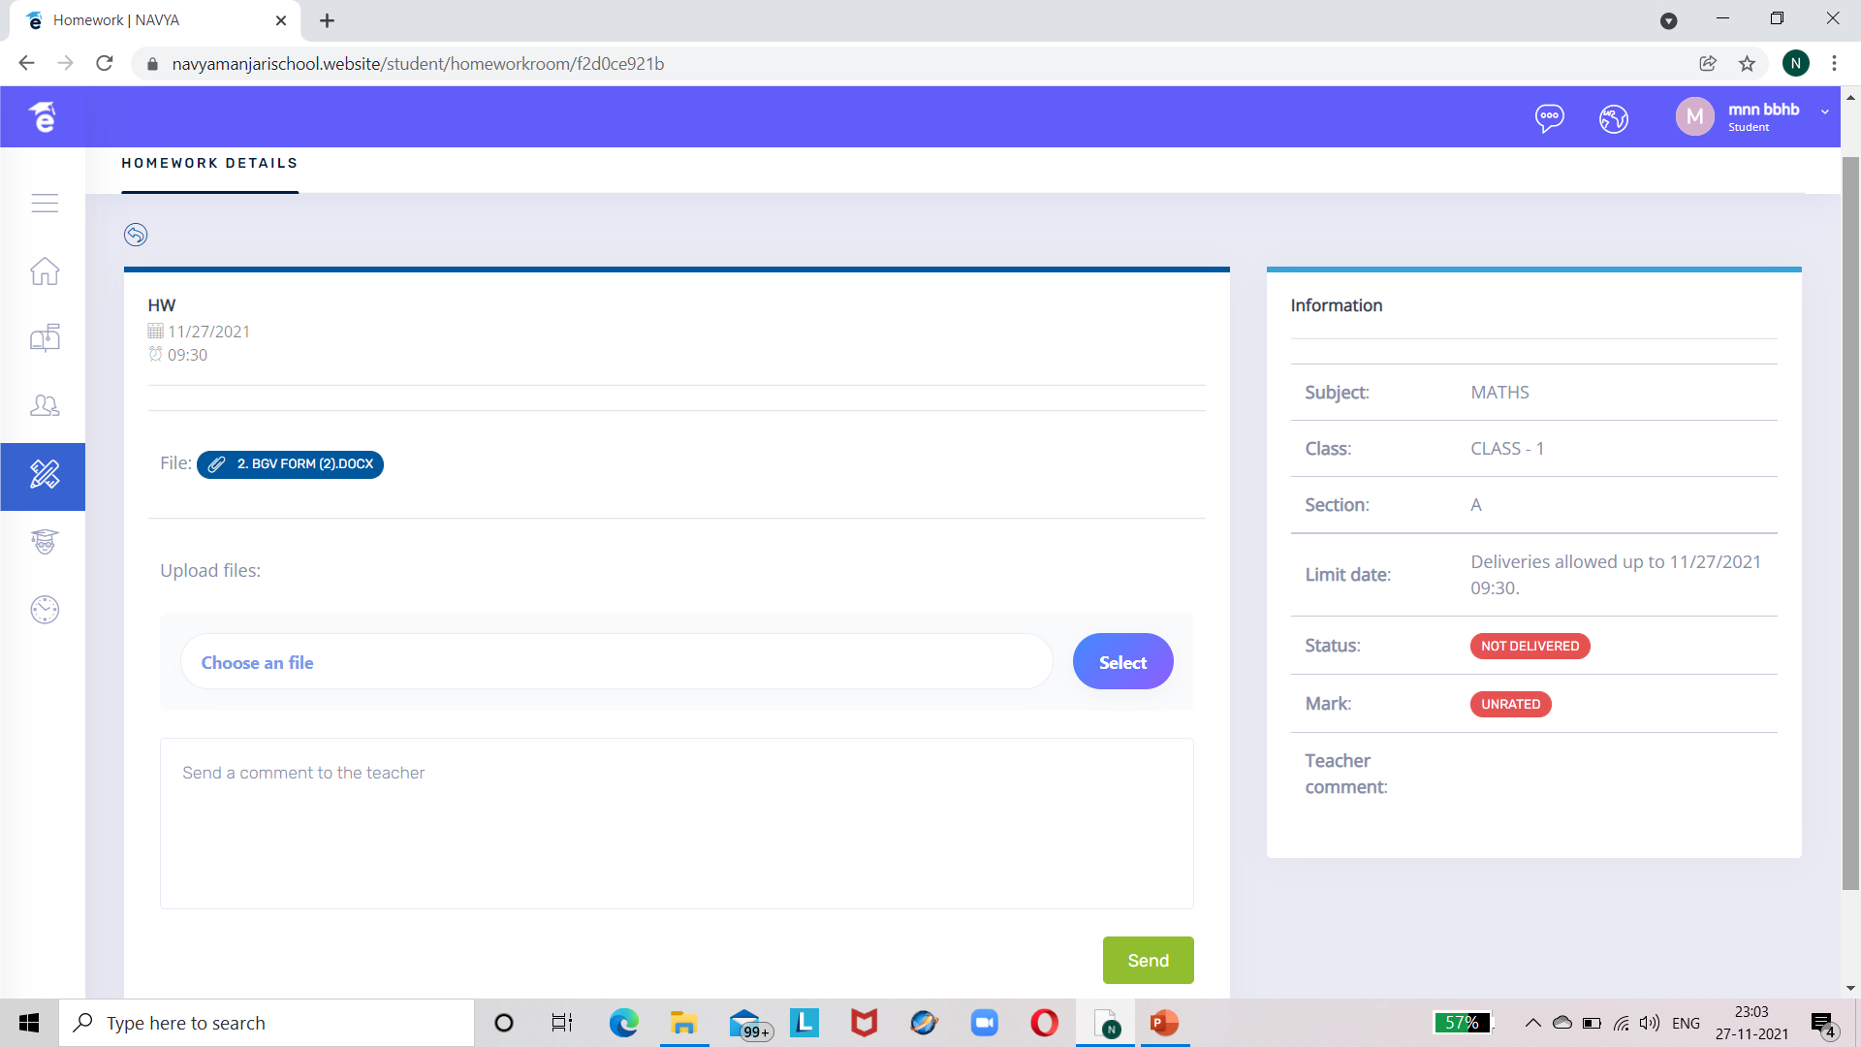

CLICK ON THE FILE TO DOWNLOAD IT

Slide 35
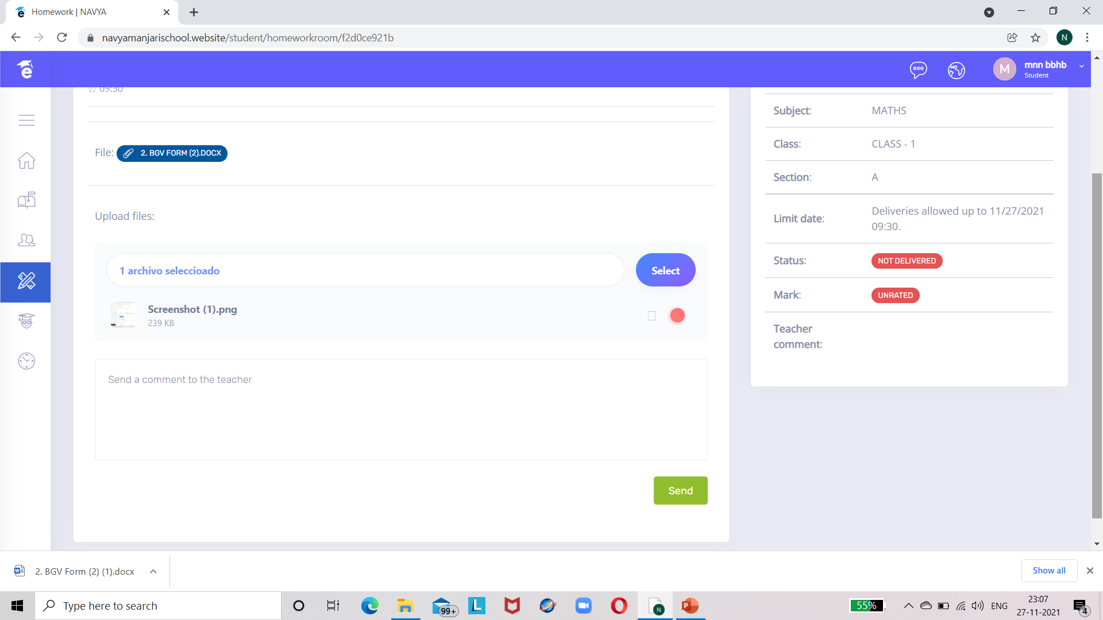


UPLOADING HOMEWORK BY STUDENT :-

Slide 36
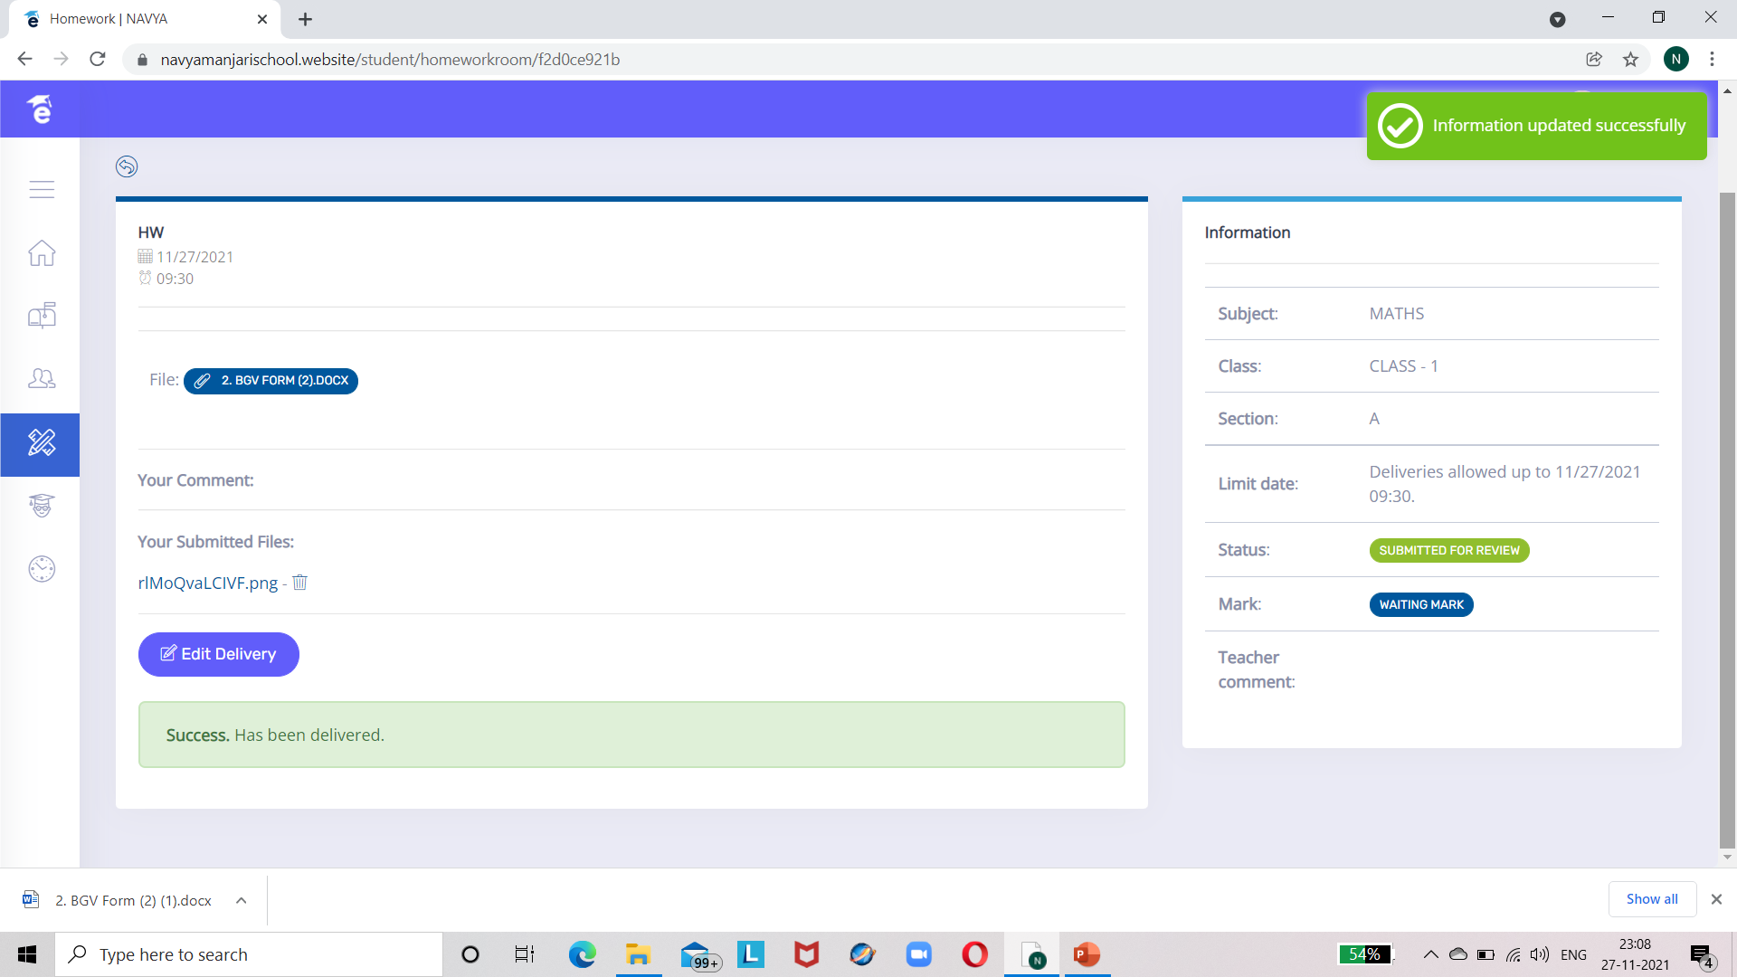

Slide 37
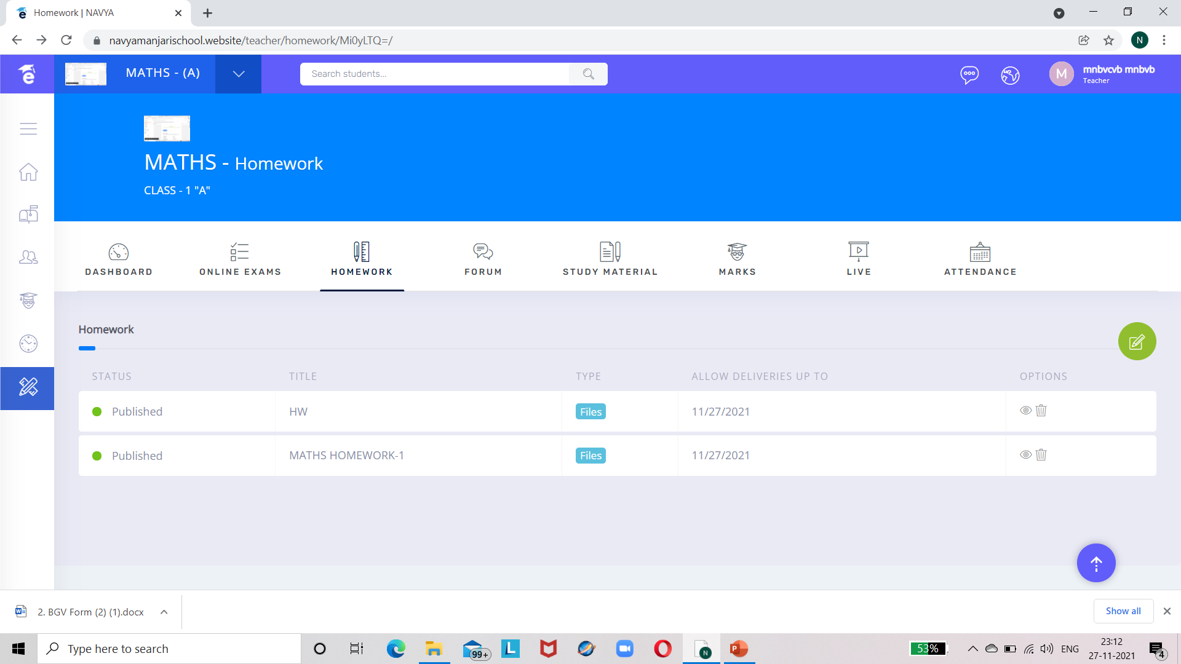
ASSIGNMENT CREATED BY ADMIN CAN ALSO BE VIEWED BY TEACHER :-

Slide 38
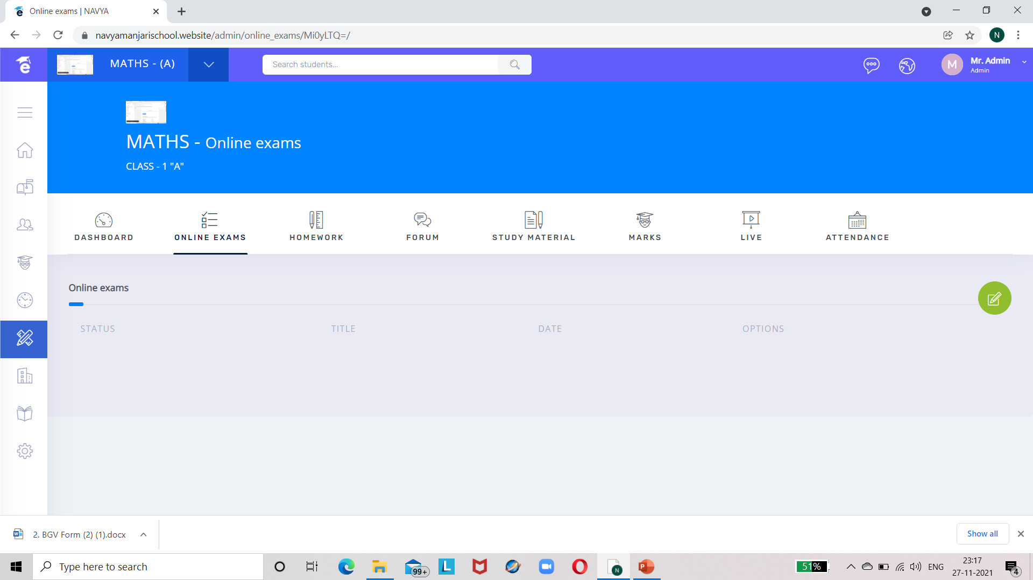

ONLINE EXAMS :-

Slide 39
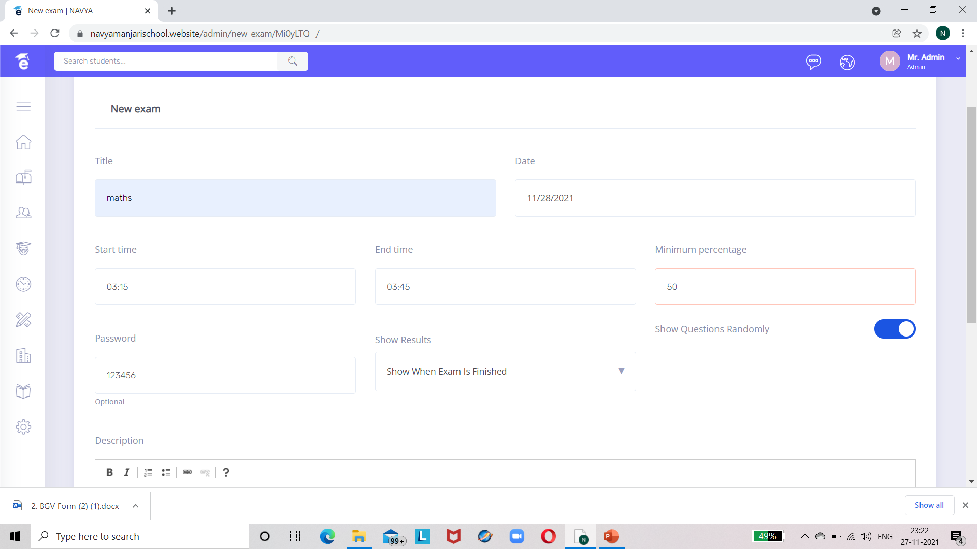

Slide 40
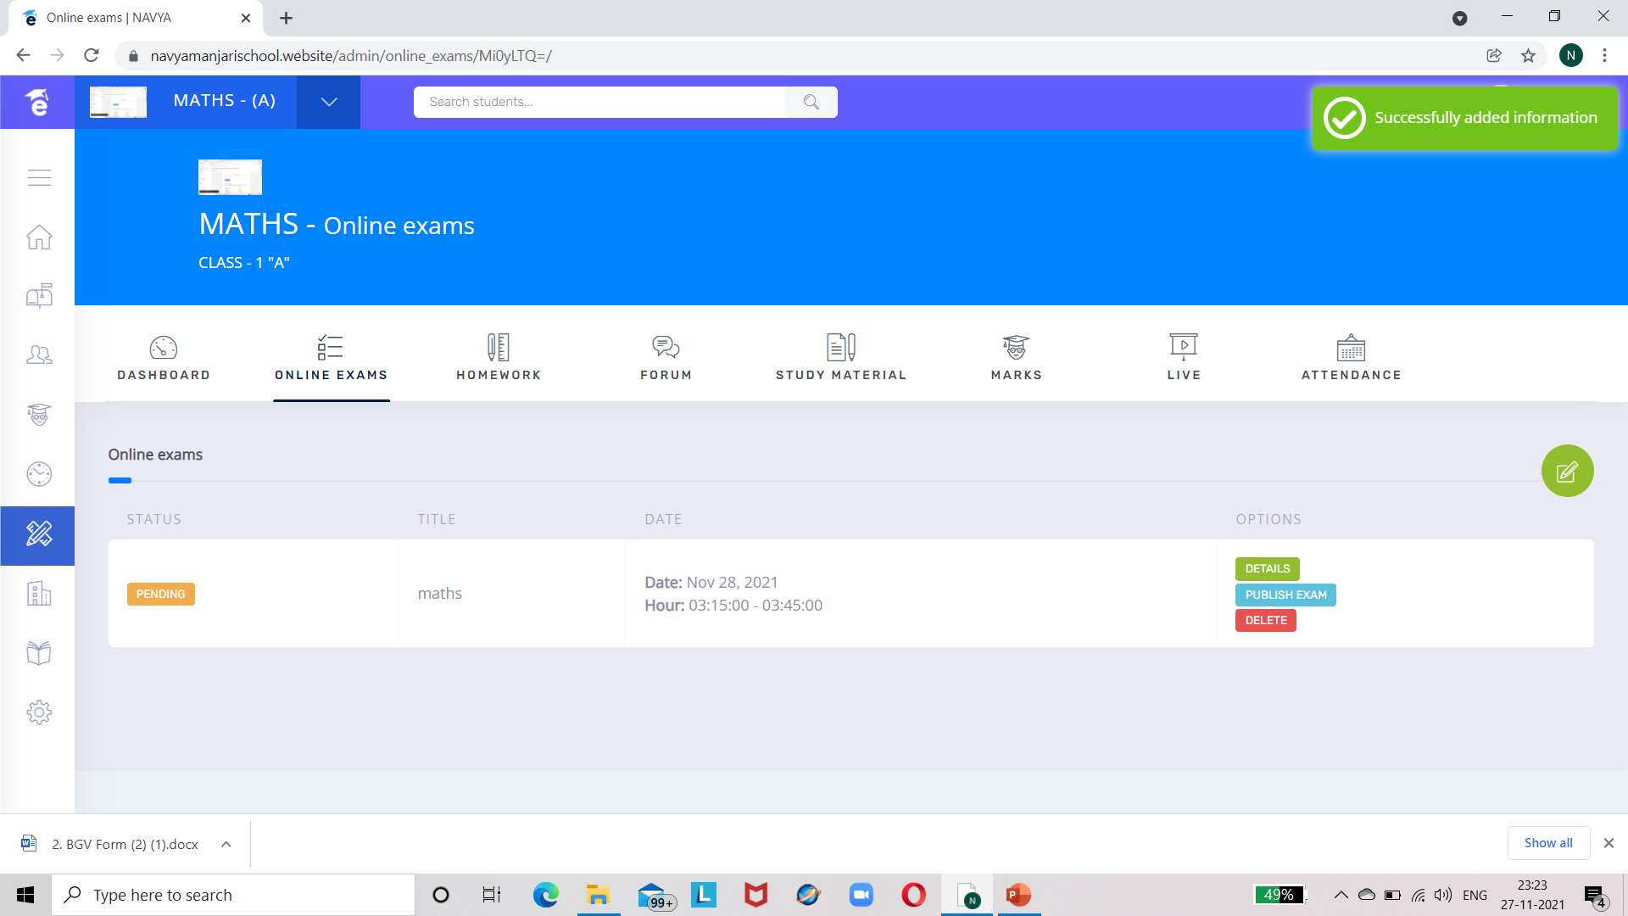


Slide 41
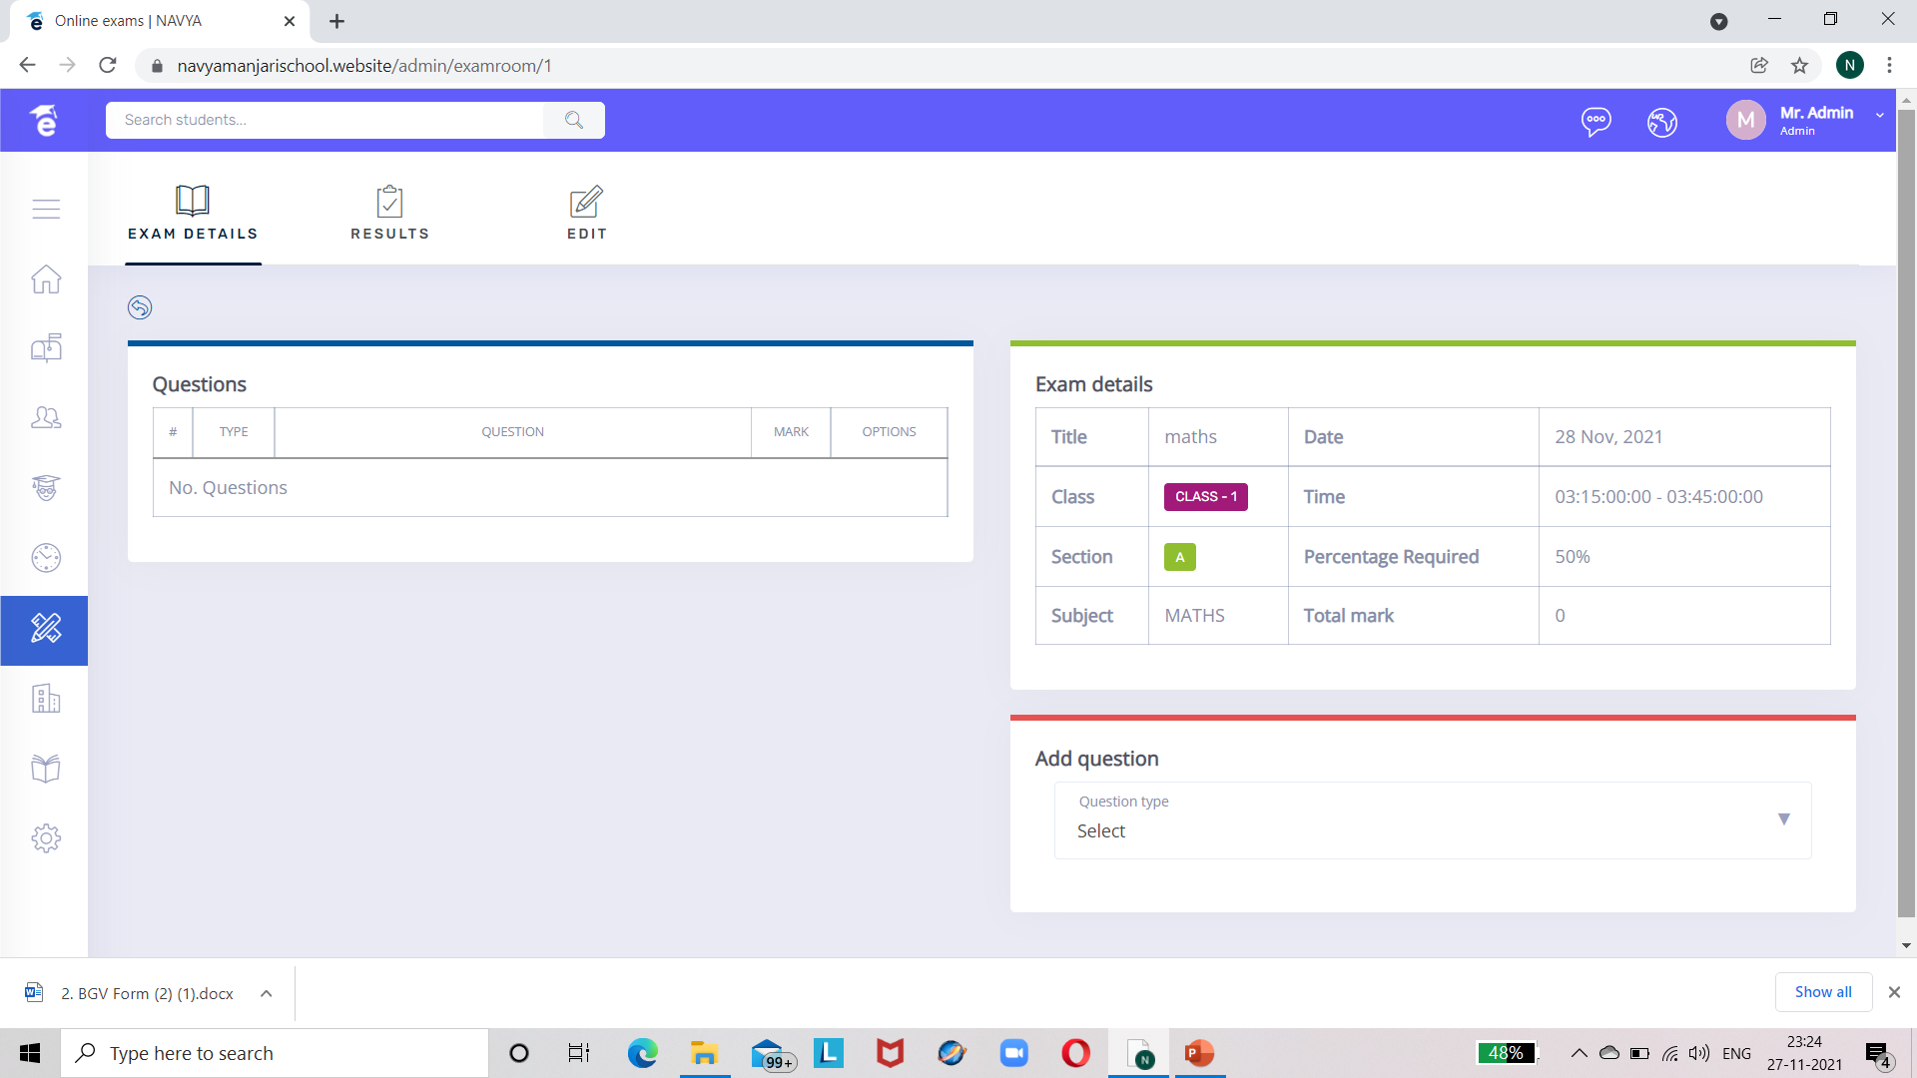
CLICK ON DETAILS TO ADD QUESTIONS

Slide 42
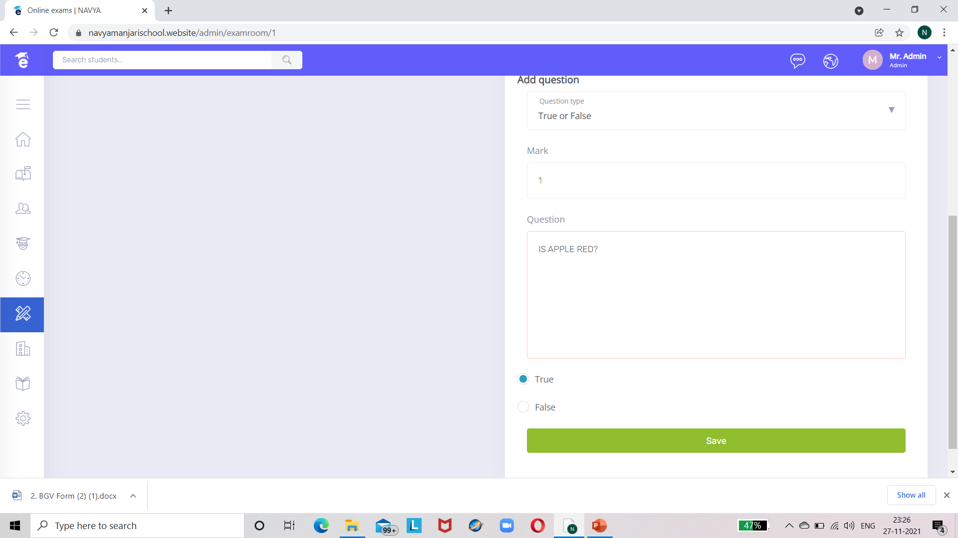

Slide 43
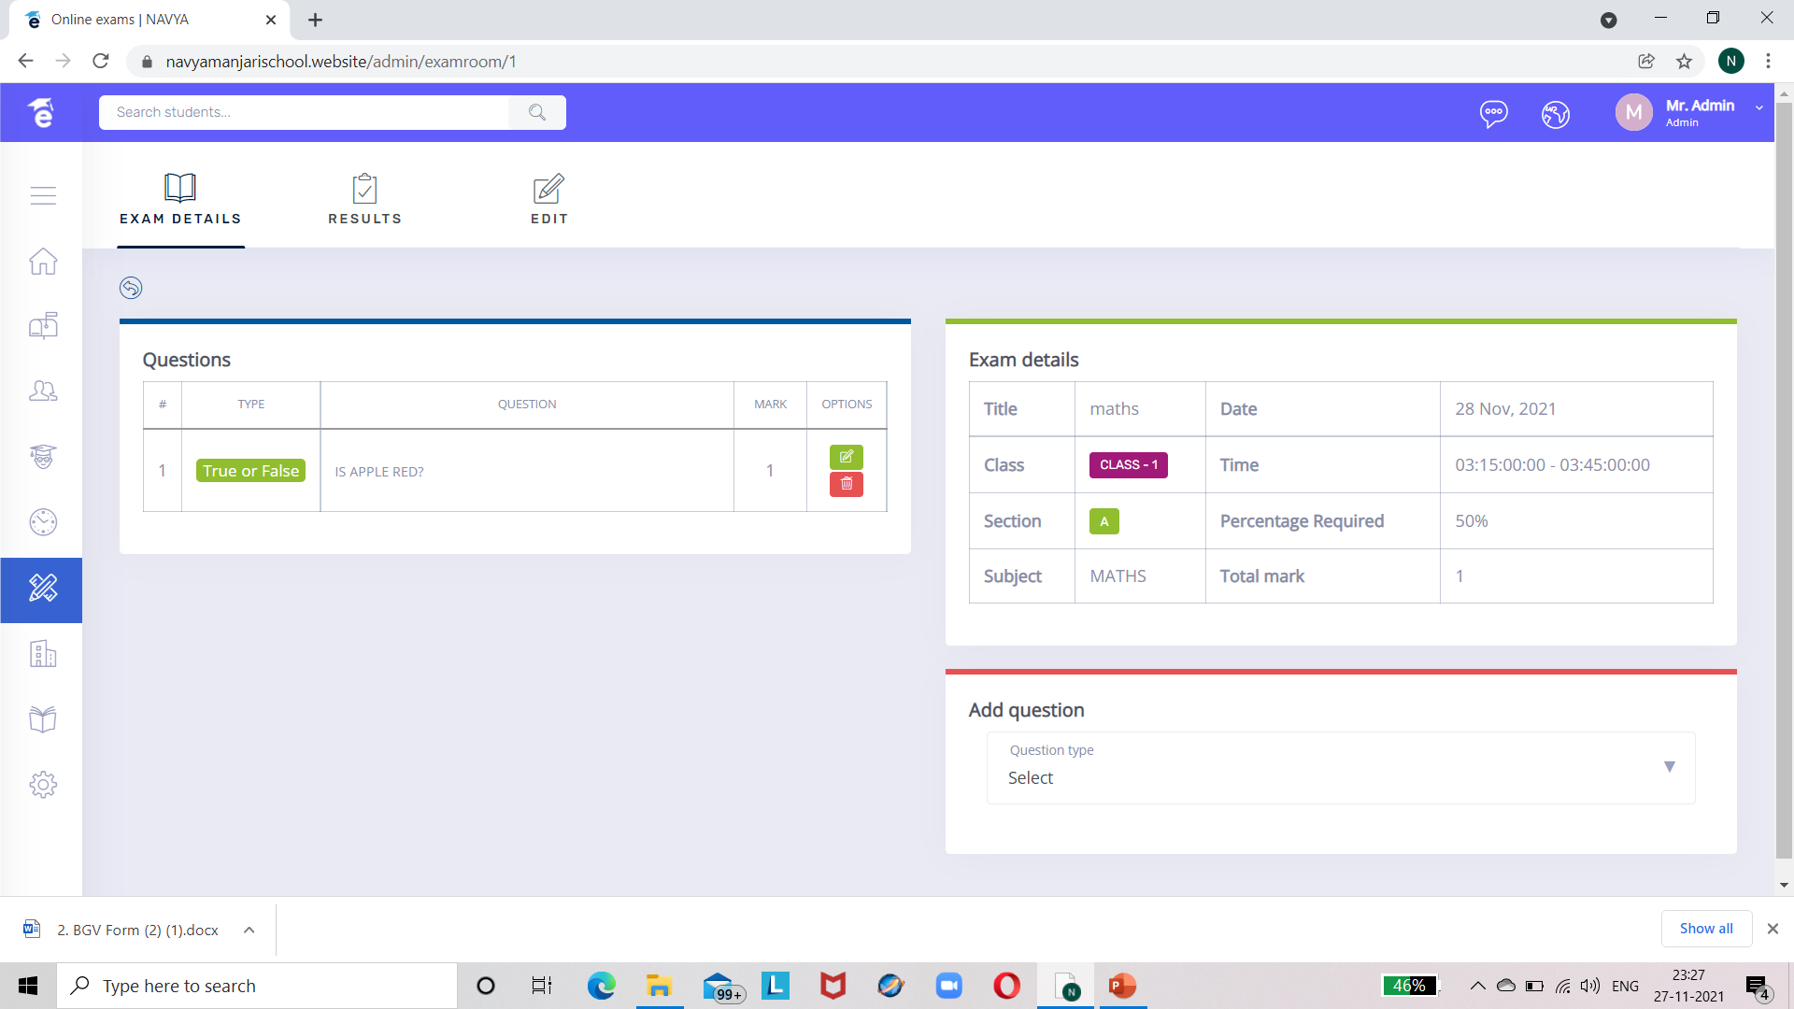

AFTER ADDING QUESTIONS CLICK ON THE ARROW BUTTON

Slide 44
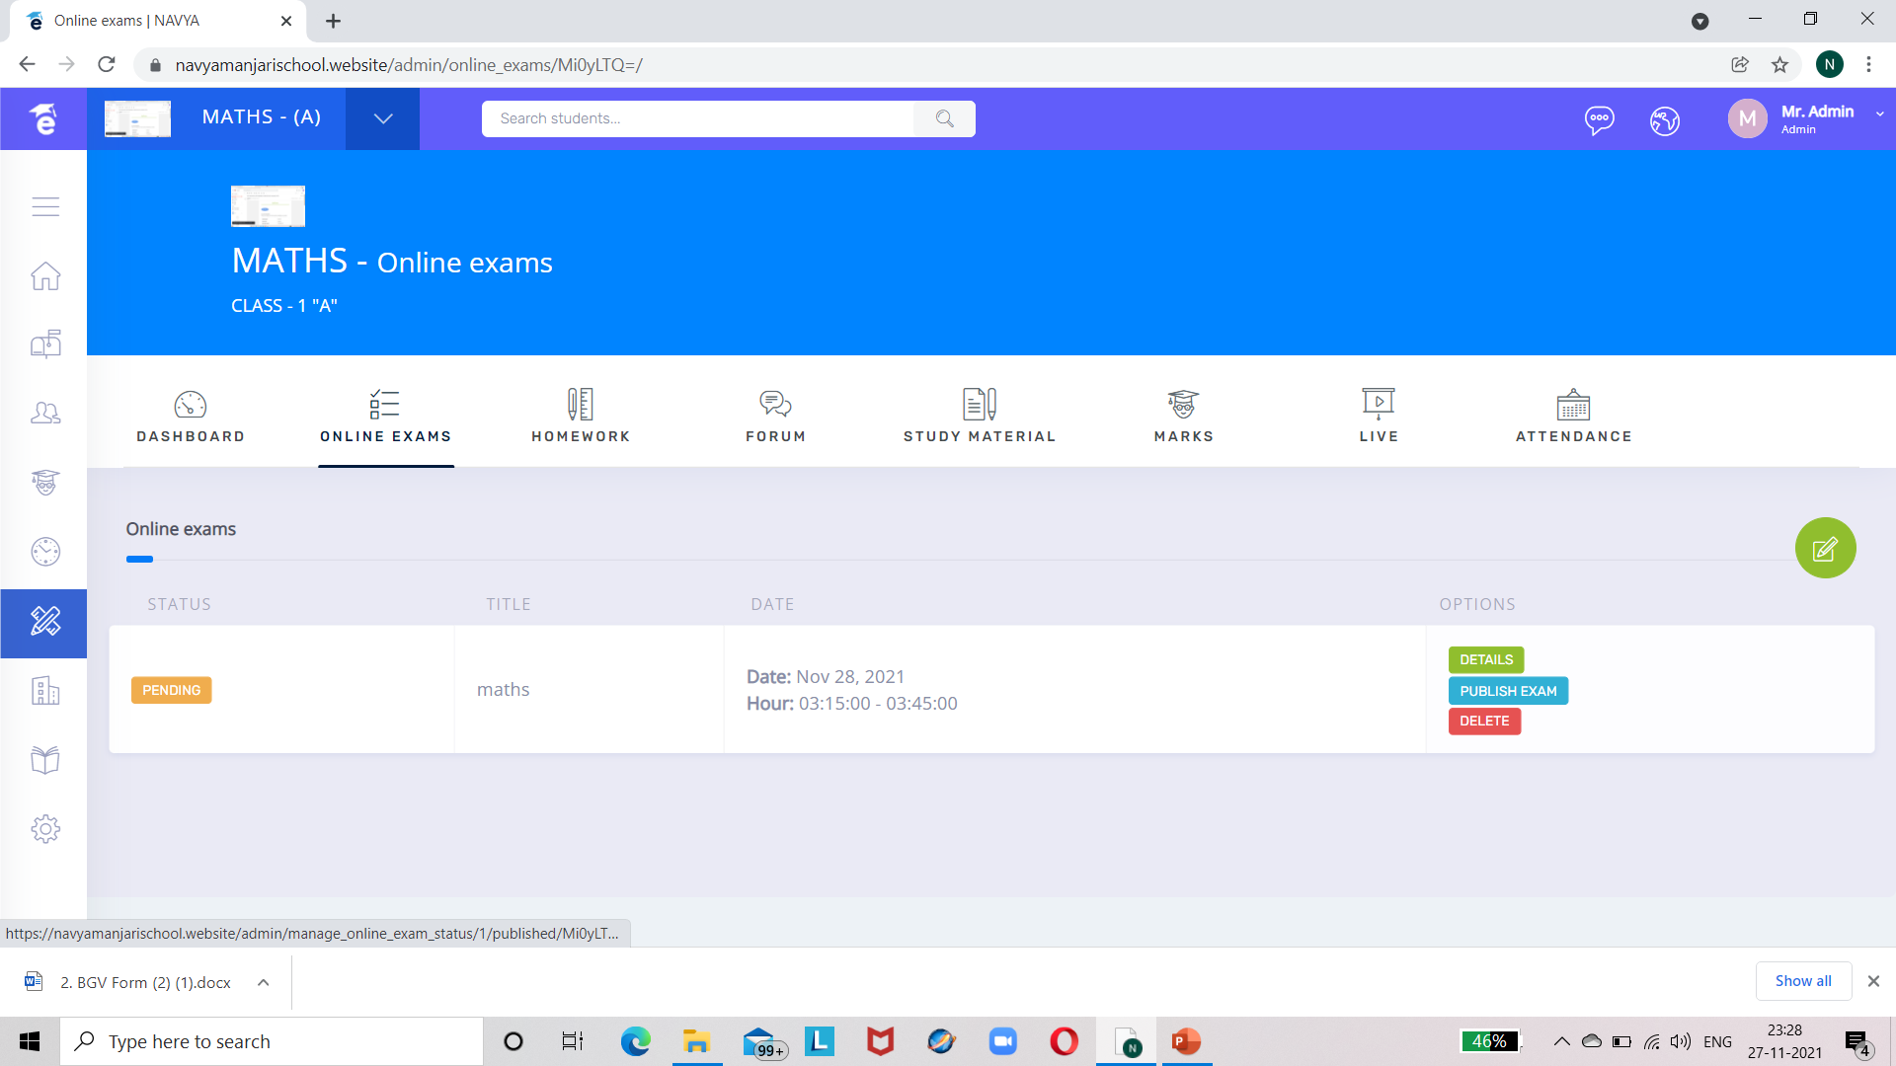

CLICK ON PUBLISH EXAM TO PUBLISH THE EXAM :-

Slide 45
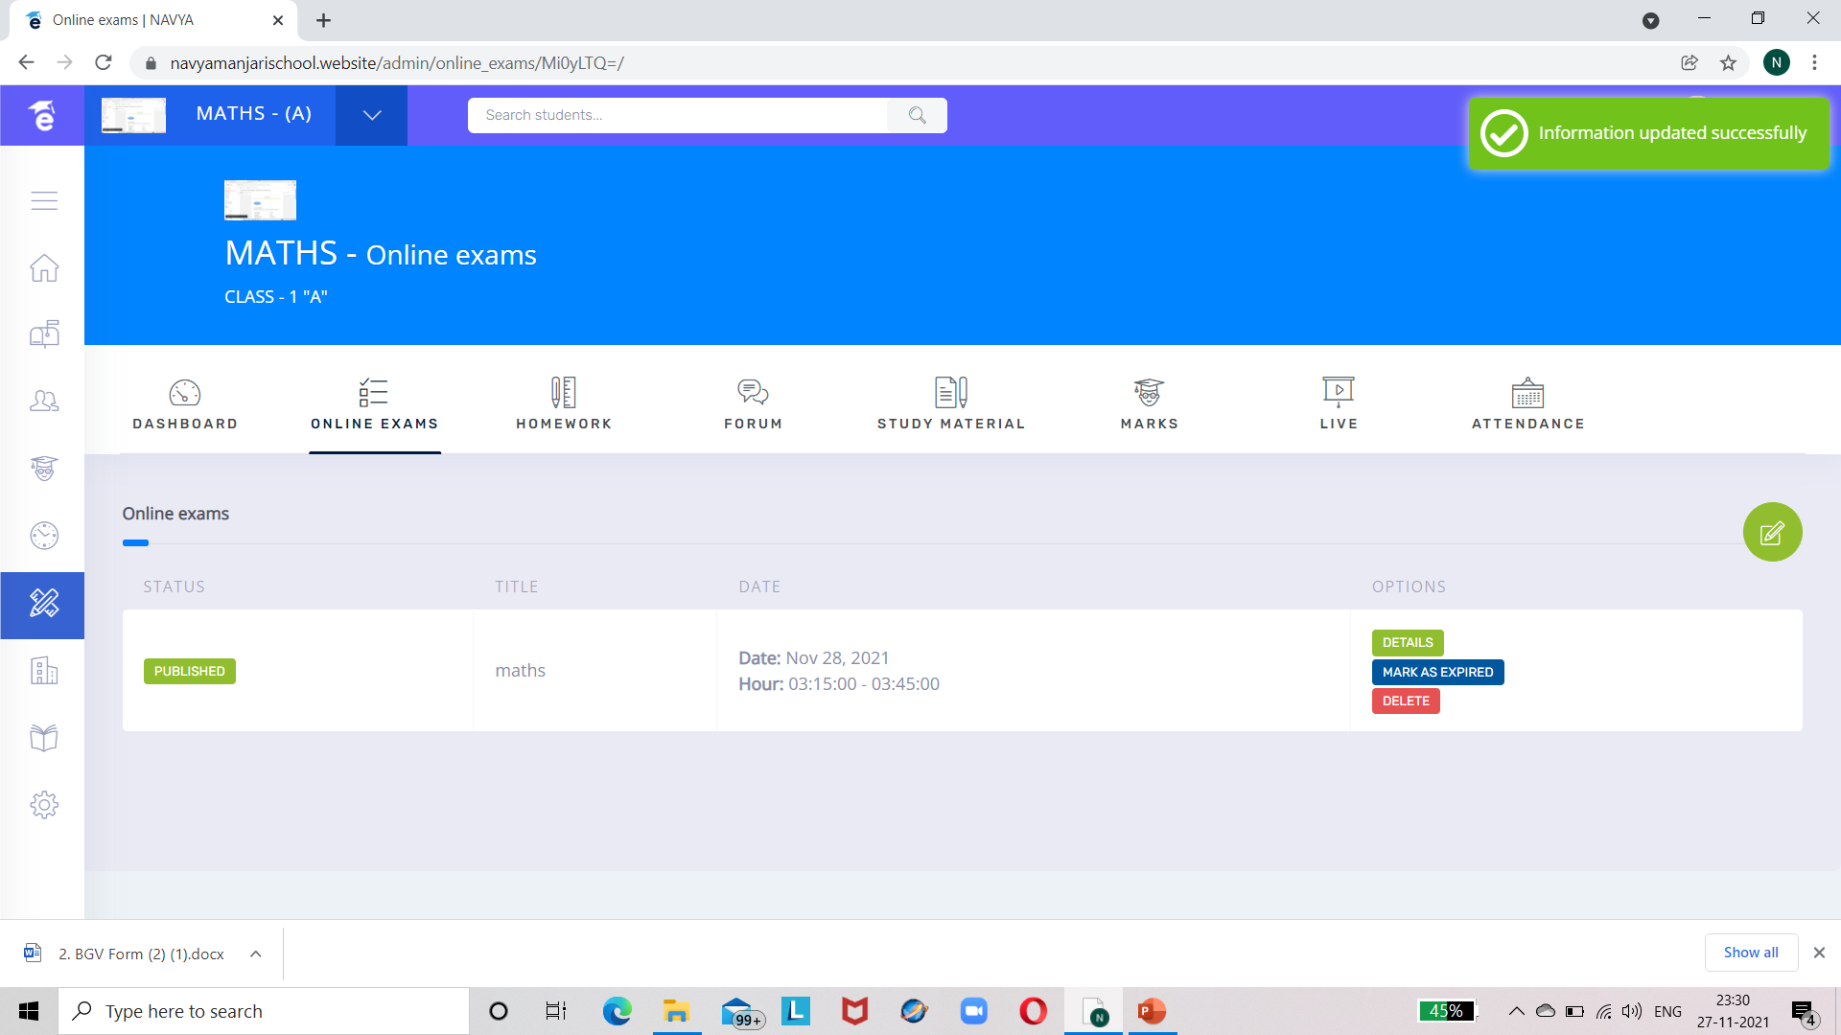
EXAM PUBLISHED

Slide 46
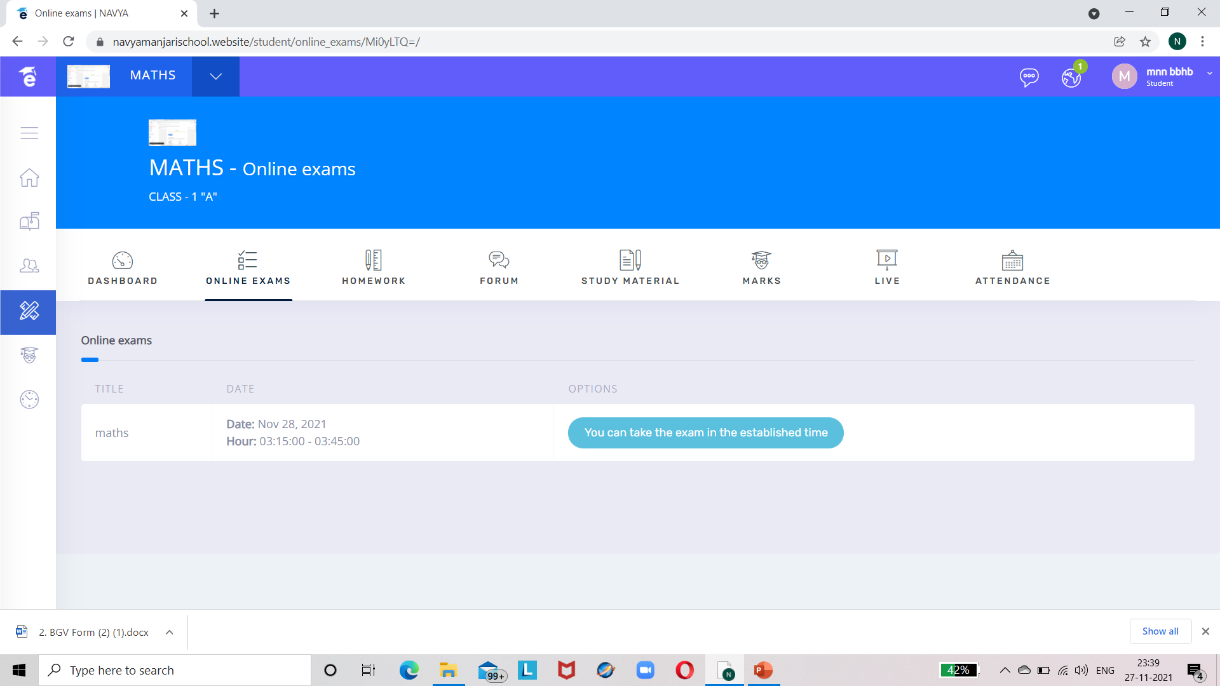
ONLINE EXAM VIEWED BY STUDENT

Slide 47
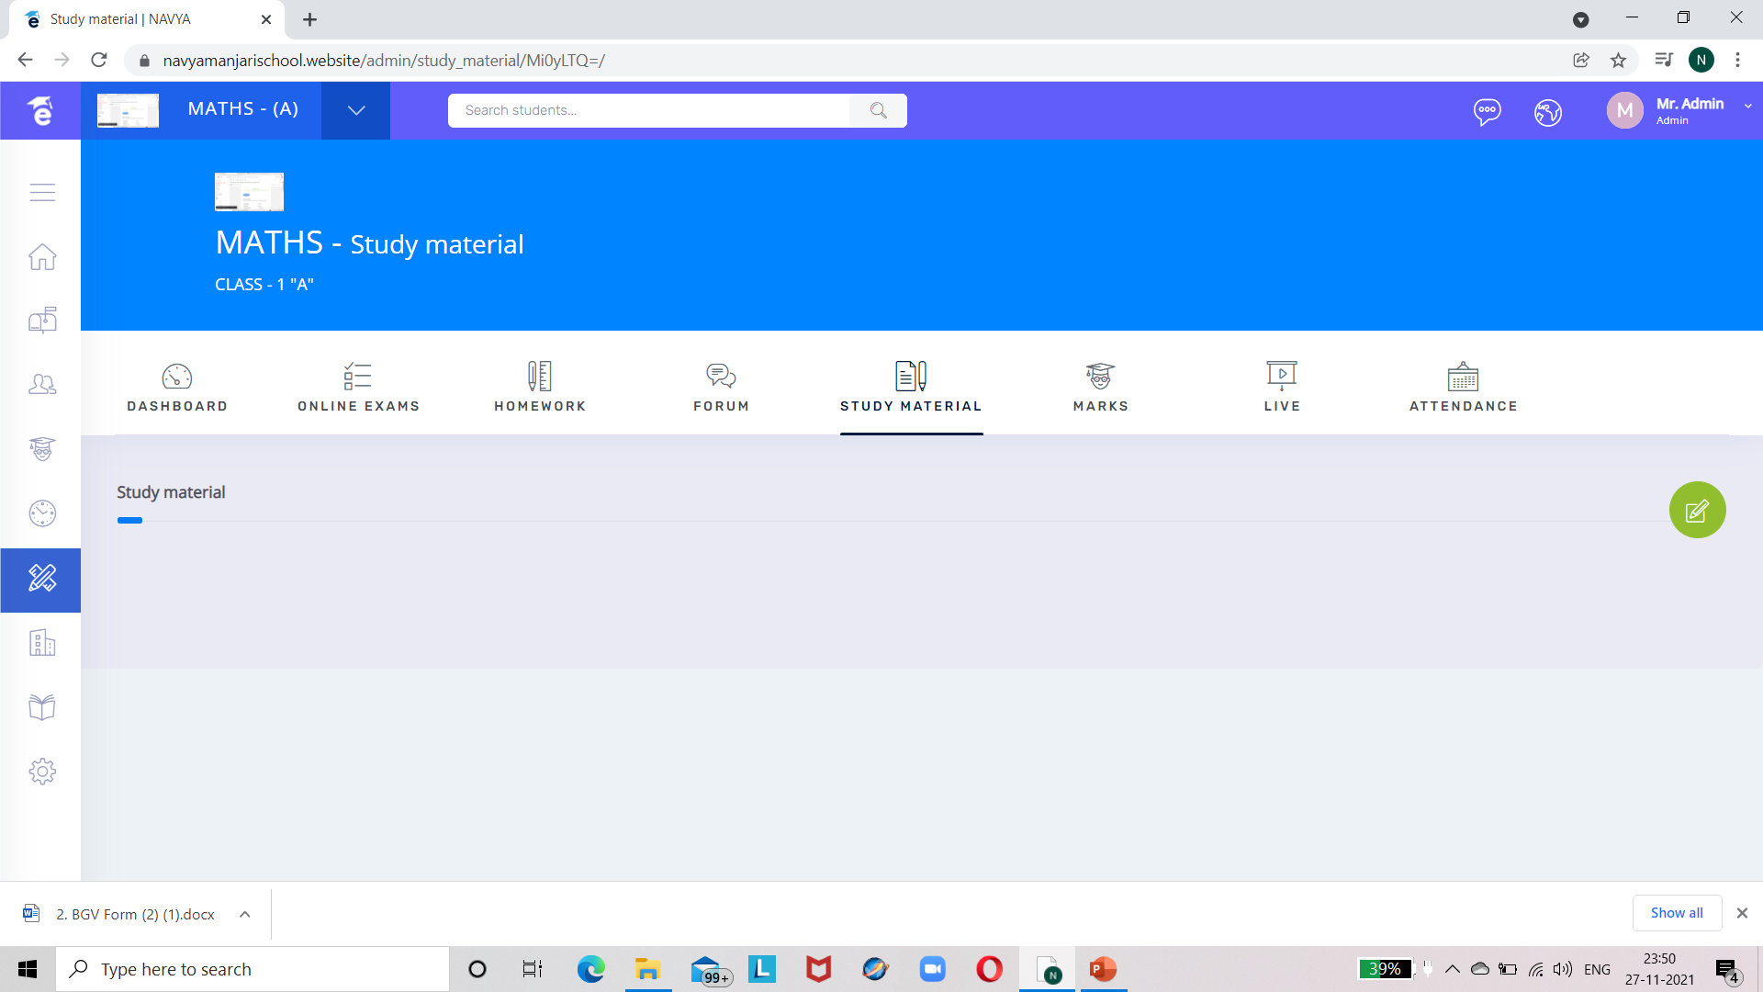
STUDY MATERIAL :-

Slide 48
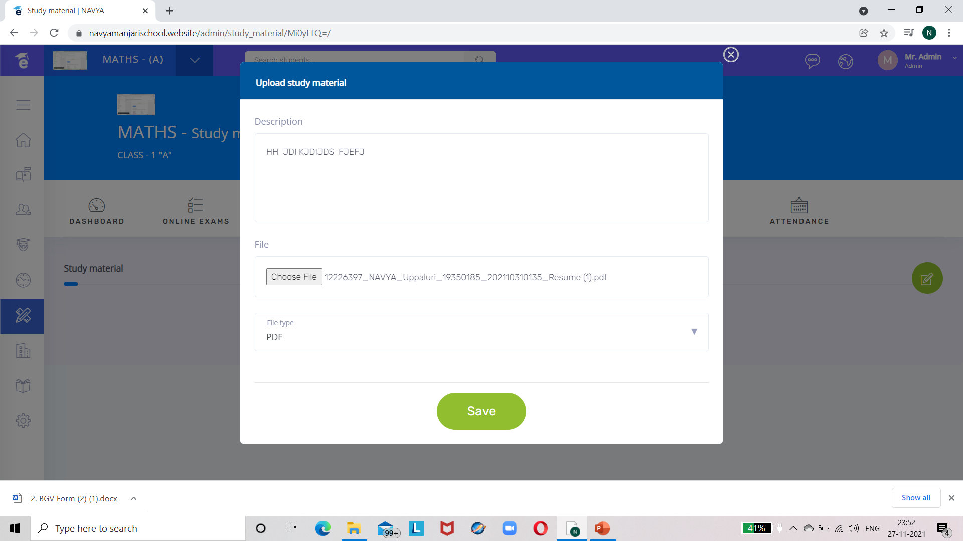
UPLOAD MATERIAL BY ADMIN :-

Slide 49
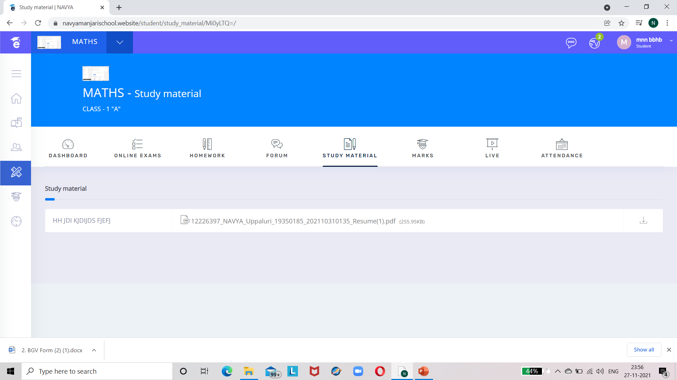
STUDY MATERIAL VIEWED BY STUDENT :-

Slide 50
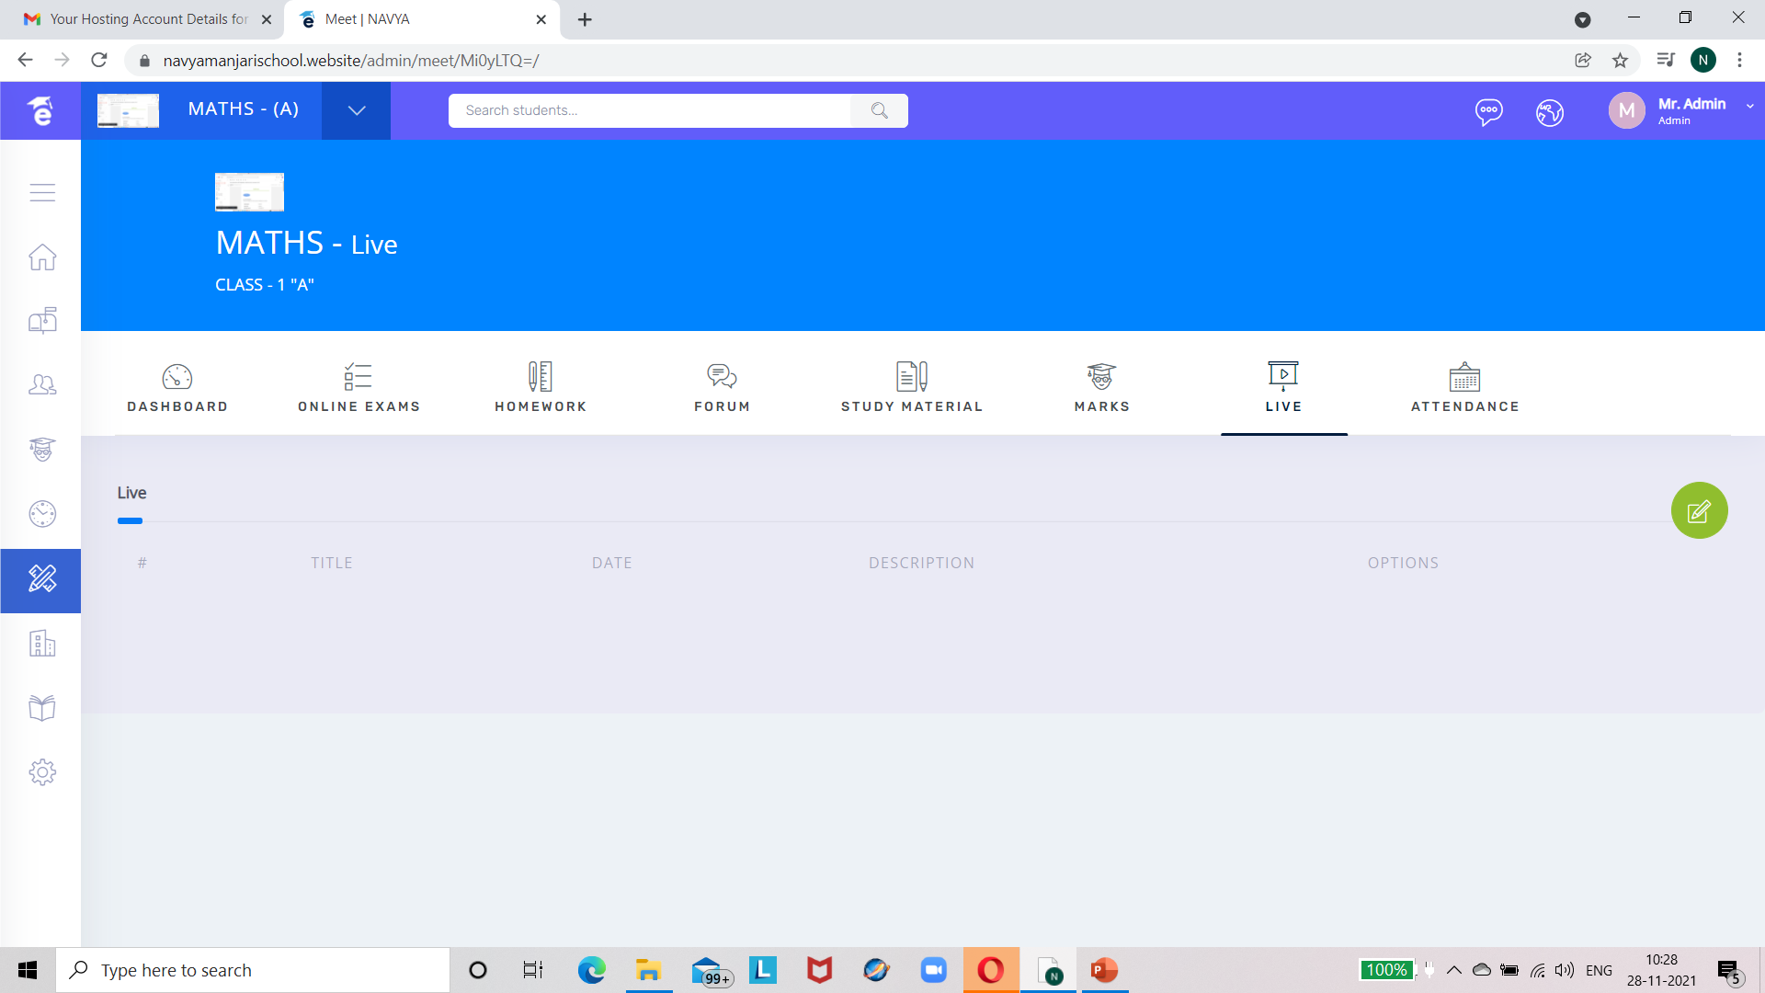
LIVE CLASSES TAB USING JITSI APP :-

Slide 51
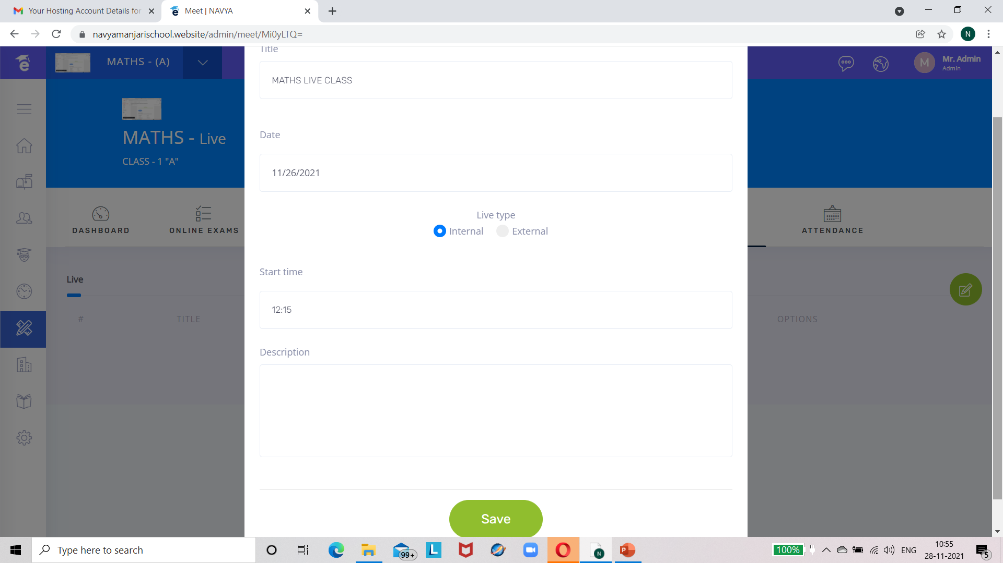
LIVE CLASS

Slide 52

CLICK ON THE BUTTON HIGHLIGHTED IN YELLOW :-

Slide 53
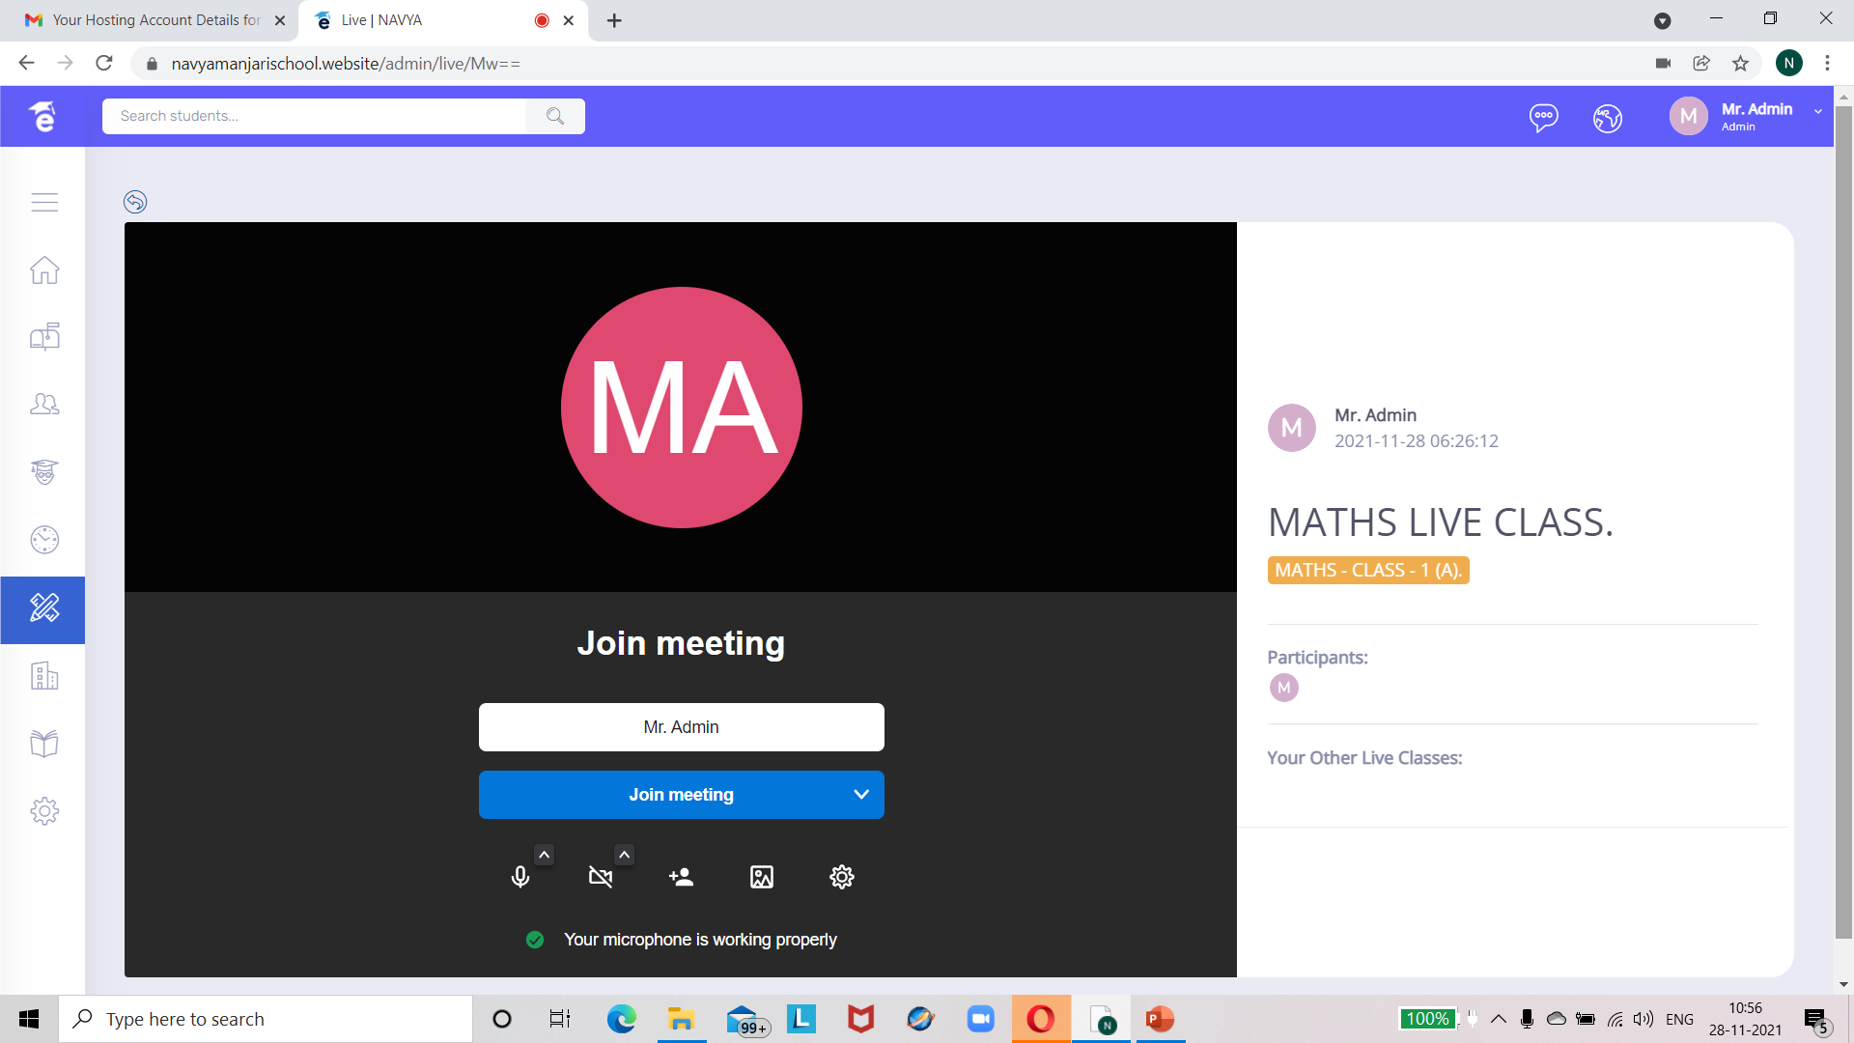

Slide 54
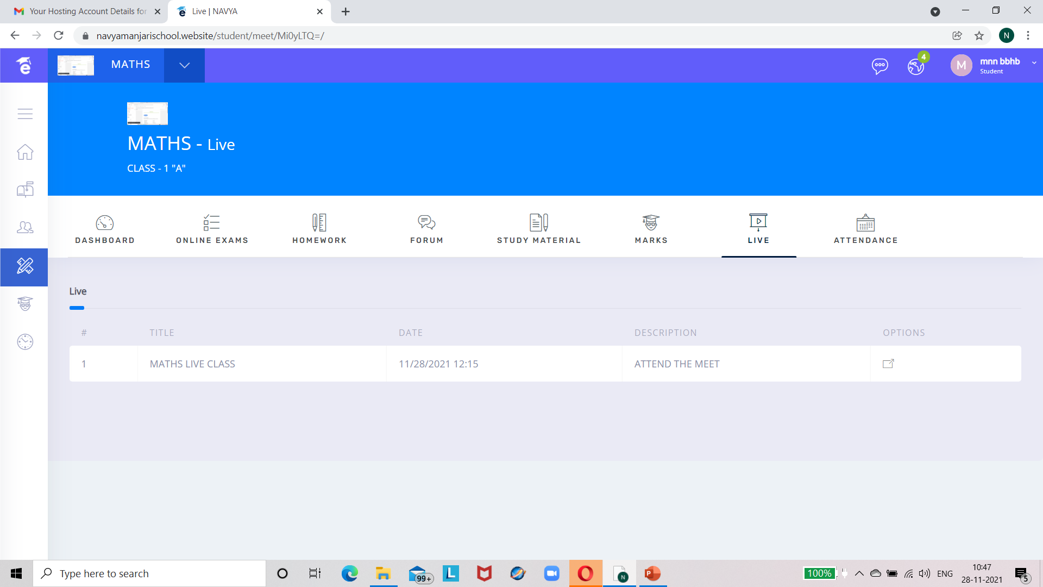
Live class viewed by student in student module.They can attend it by clicking on the icon highlighted in yellow :-

Slide 55
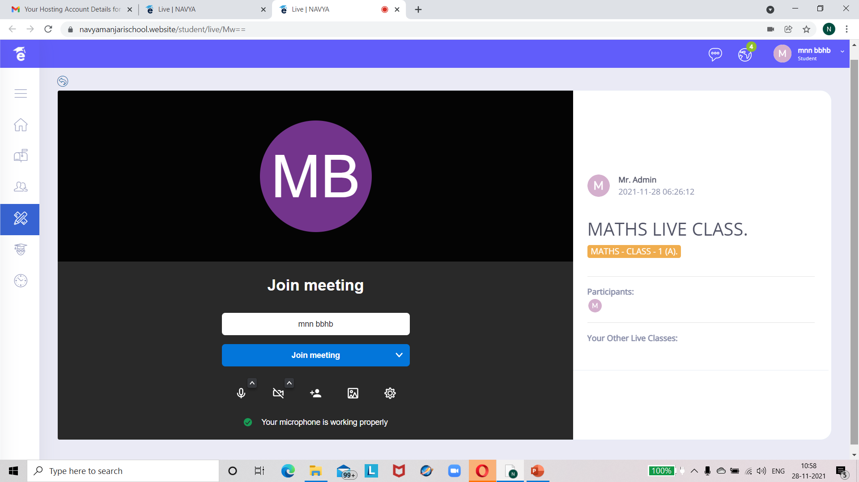
CLICK ON JOIN MEETING

Slide 56

VIEW IN STUDENT MODULE

Slide 57

VIEW IN ADMIN MODULE

Slide 58

VIEW WHEN TEACHER,STUDENT,ADMIN JOINED :-

